Slide 1
Gaming your Pedagogy:
Games and Game-Design Basics for All
Dr. Renee Jackson
Assistant Professor
Program Head of Art Education

Slide 2
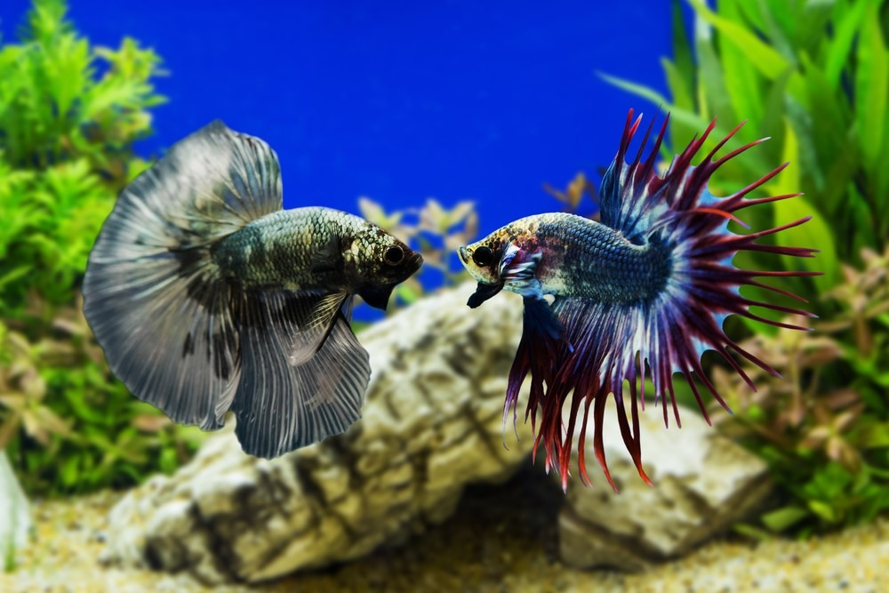

Slide 3
A Brief History of Games

Slide 4
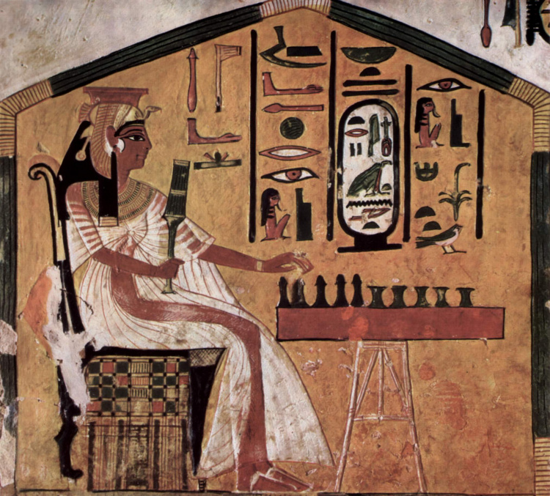

Slide 5
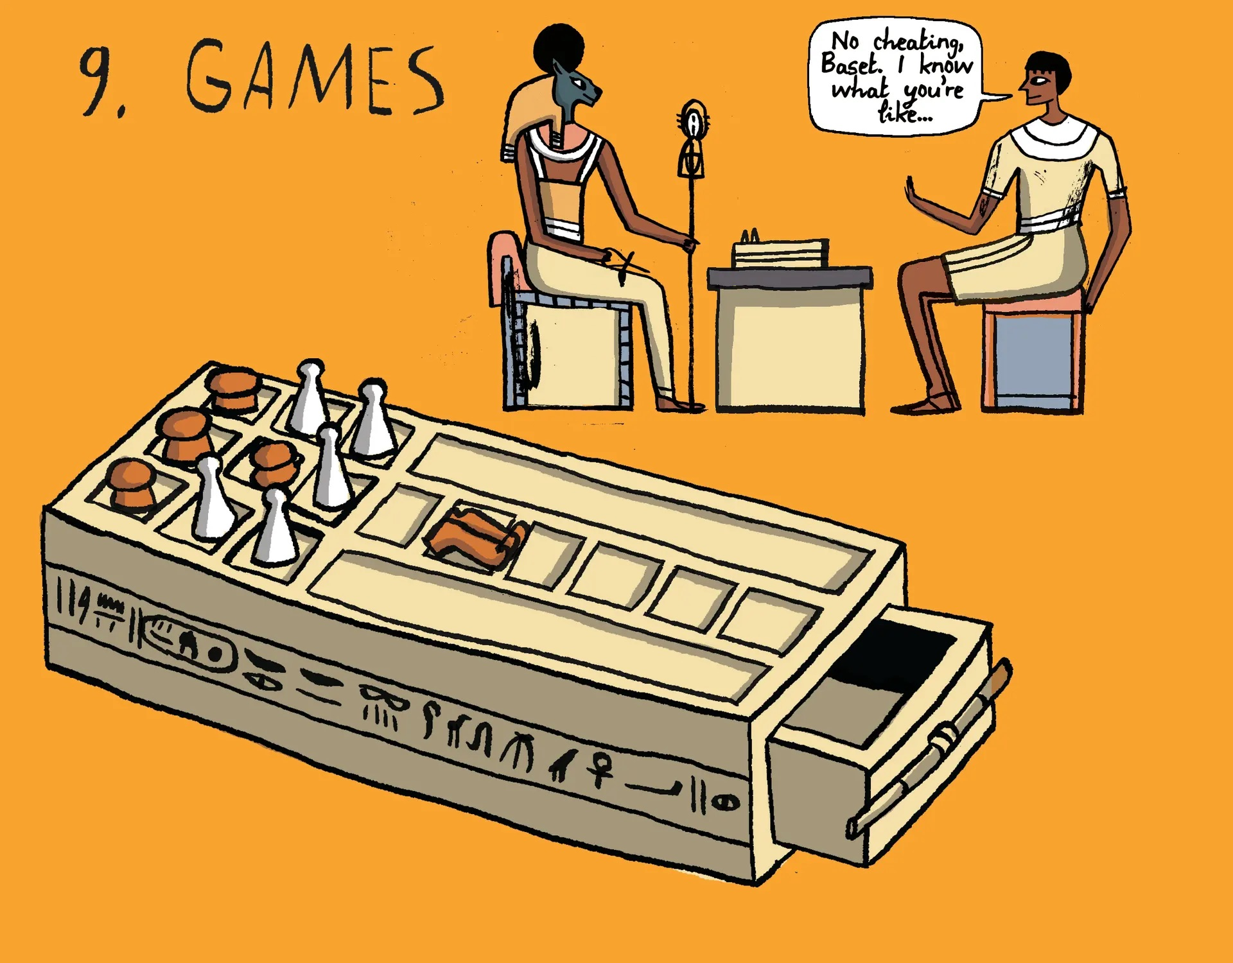

Slide 6
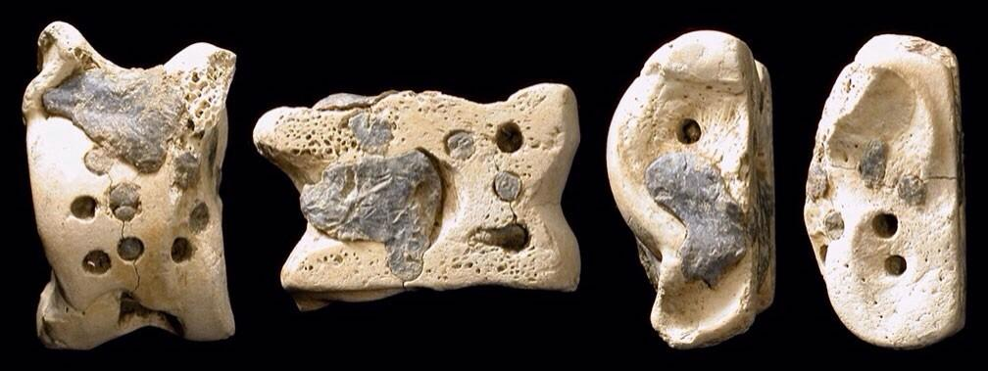

Slide 7
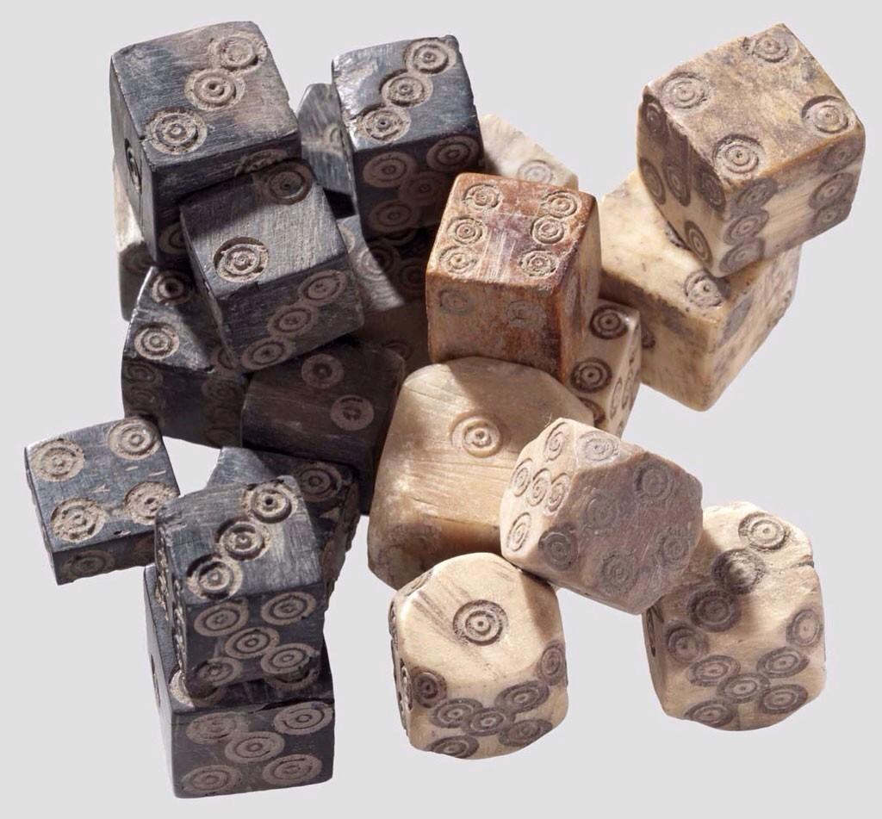

Slide 8
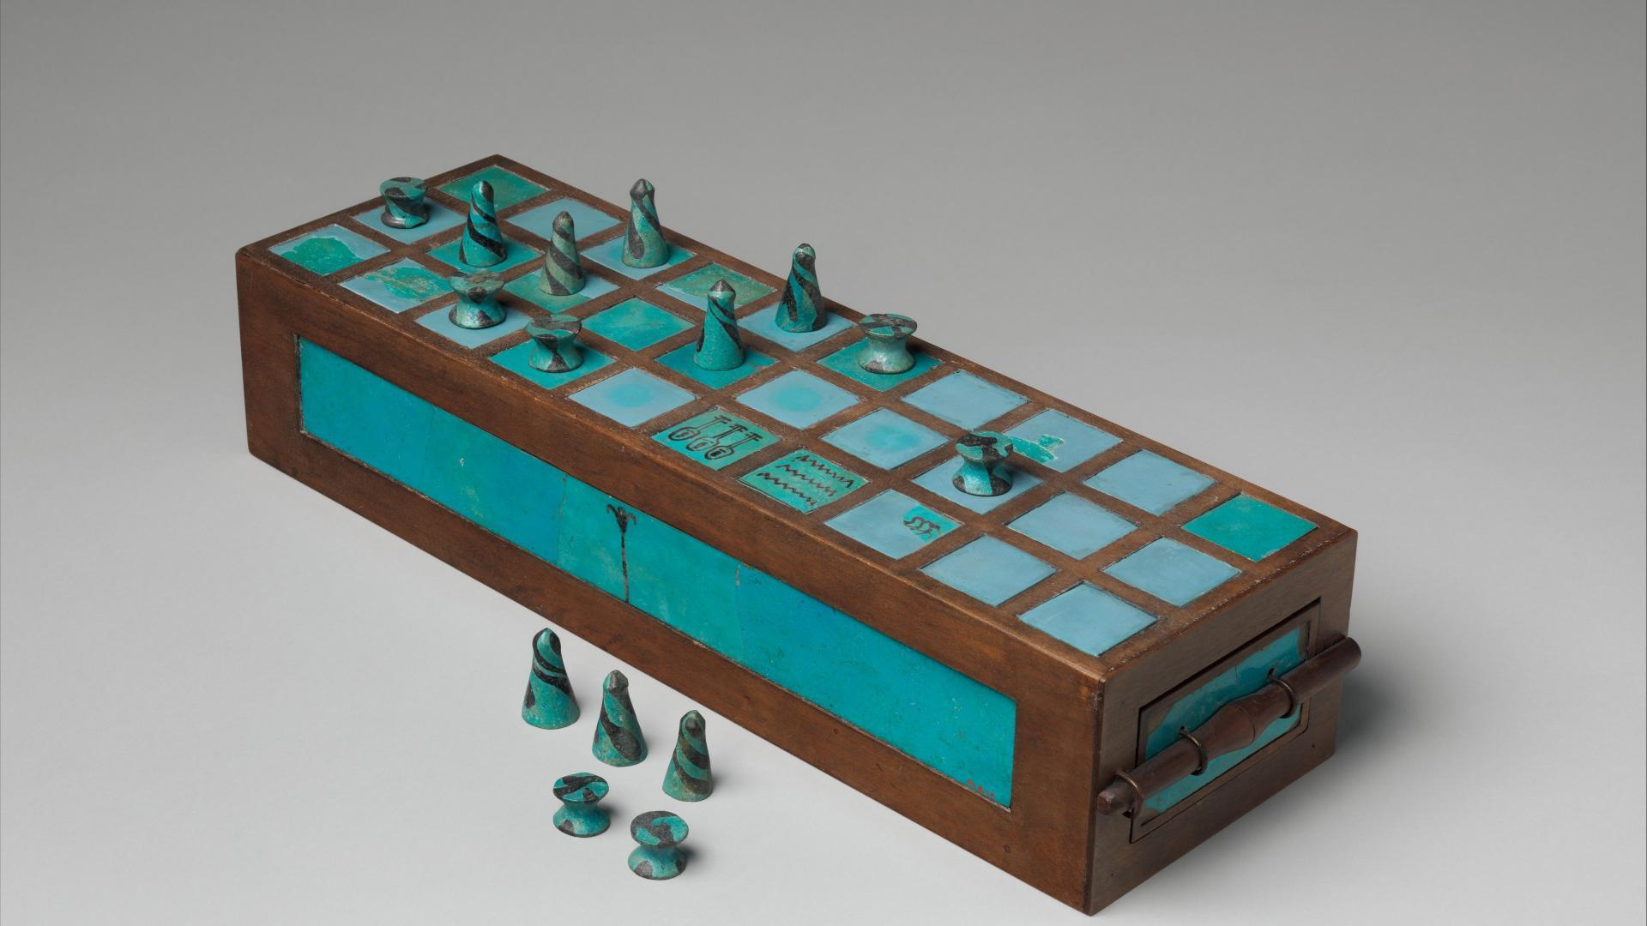

Slide 9
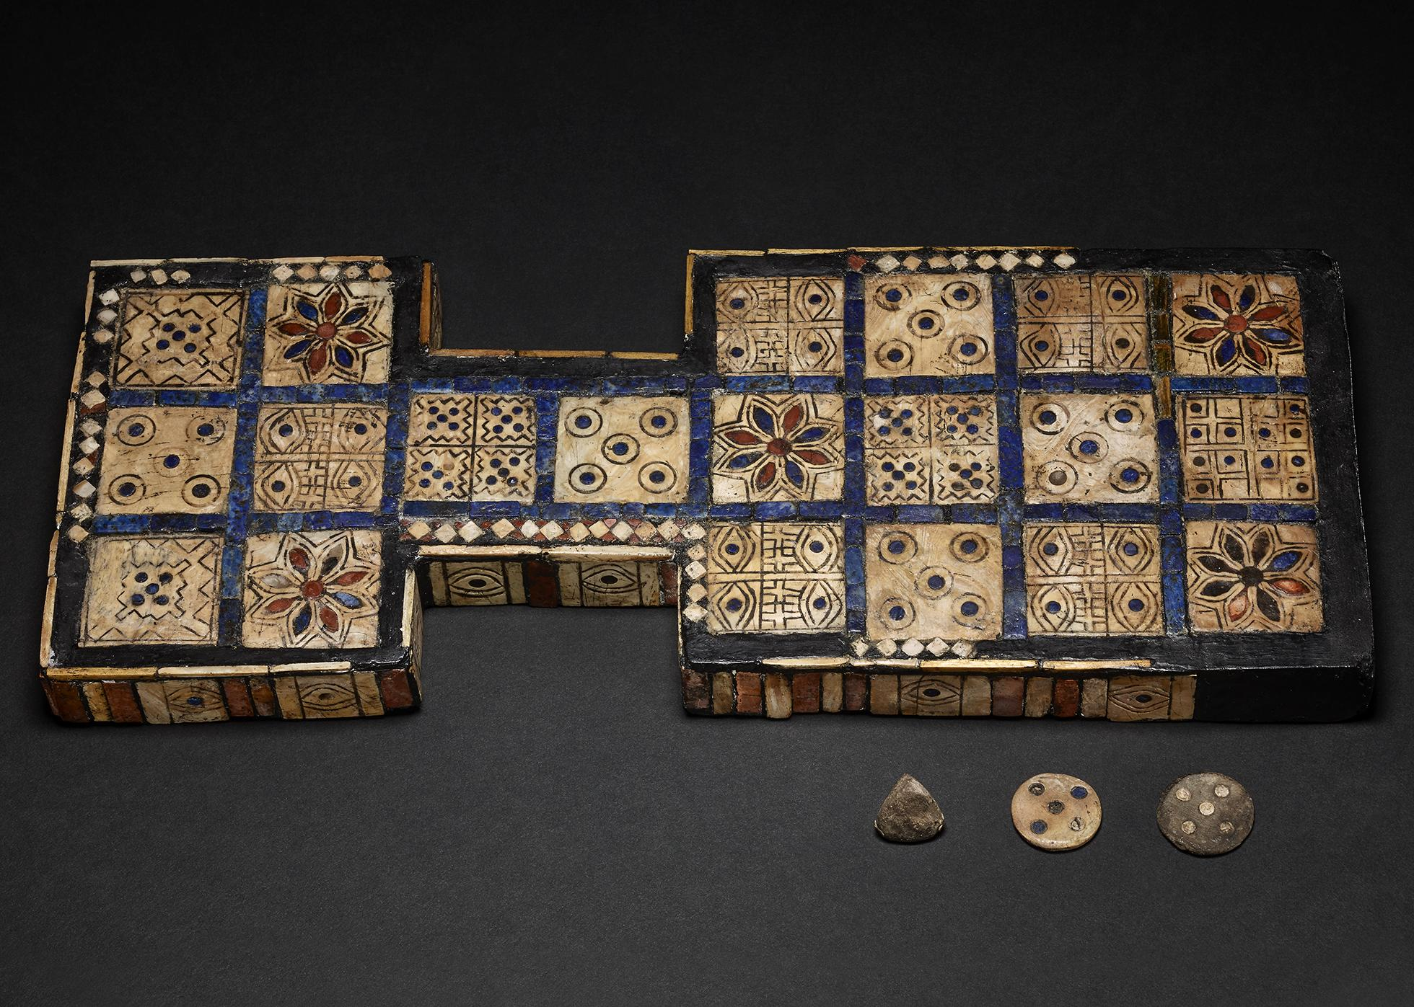

Slide 10
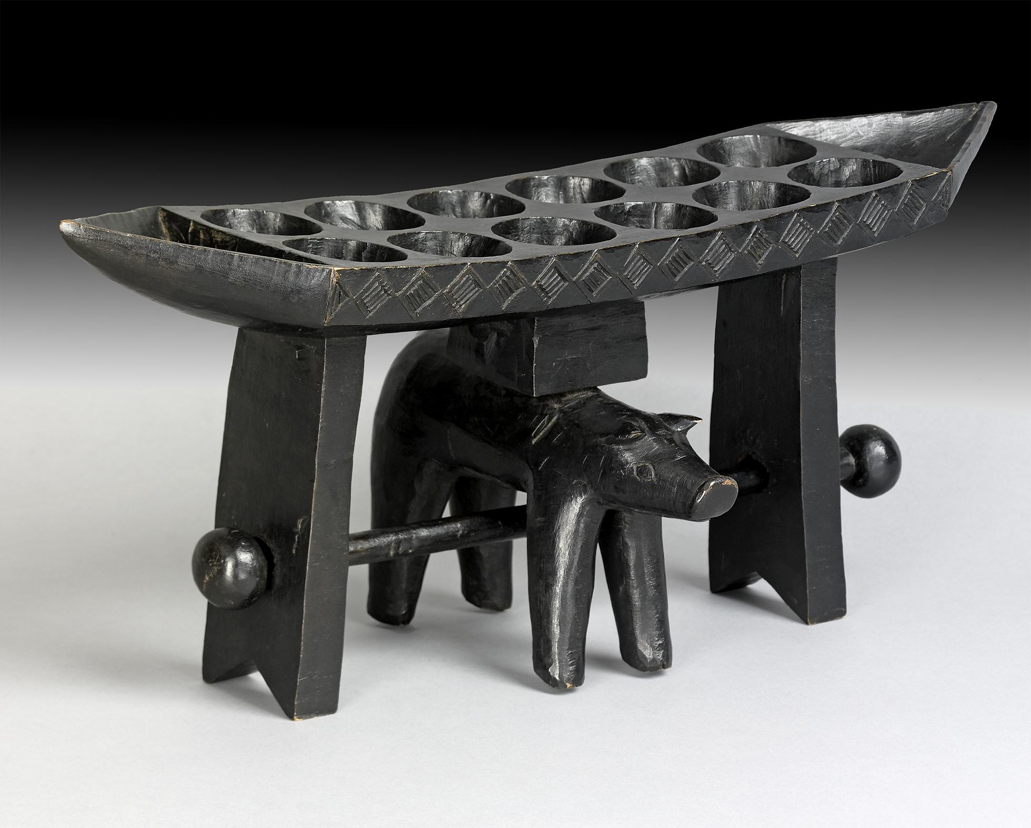

Slide 11
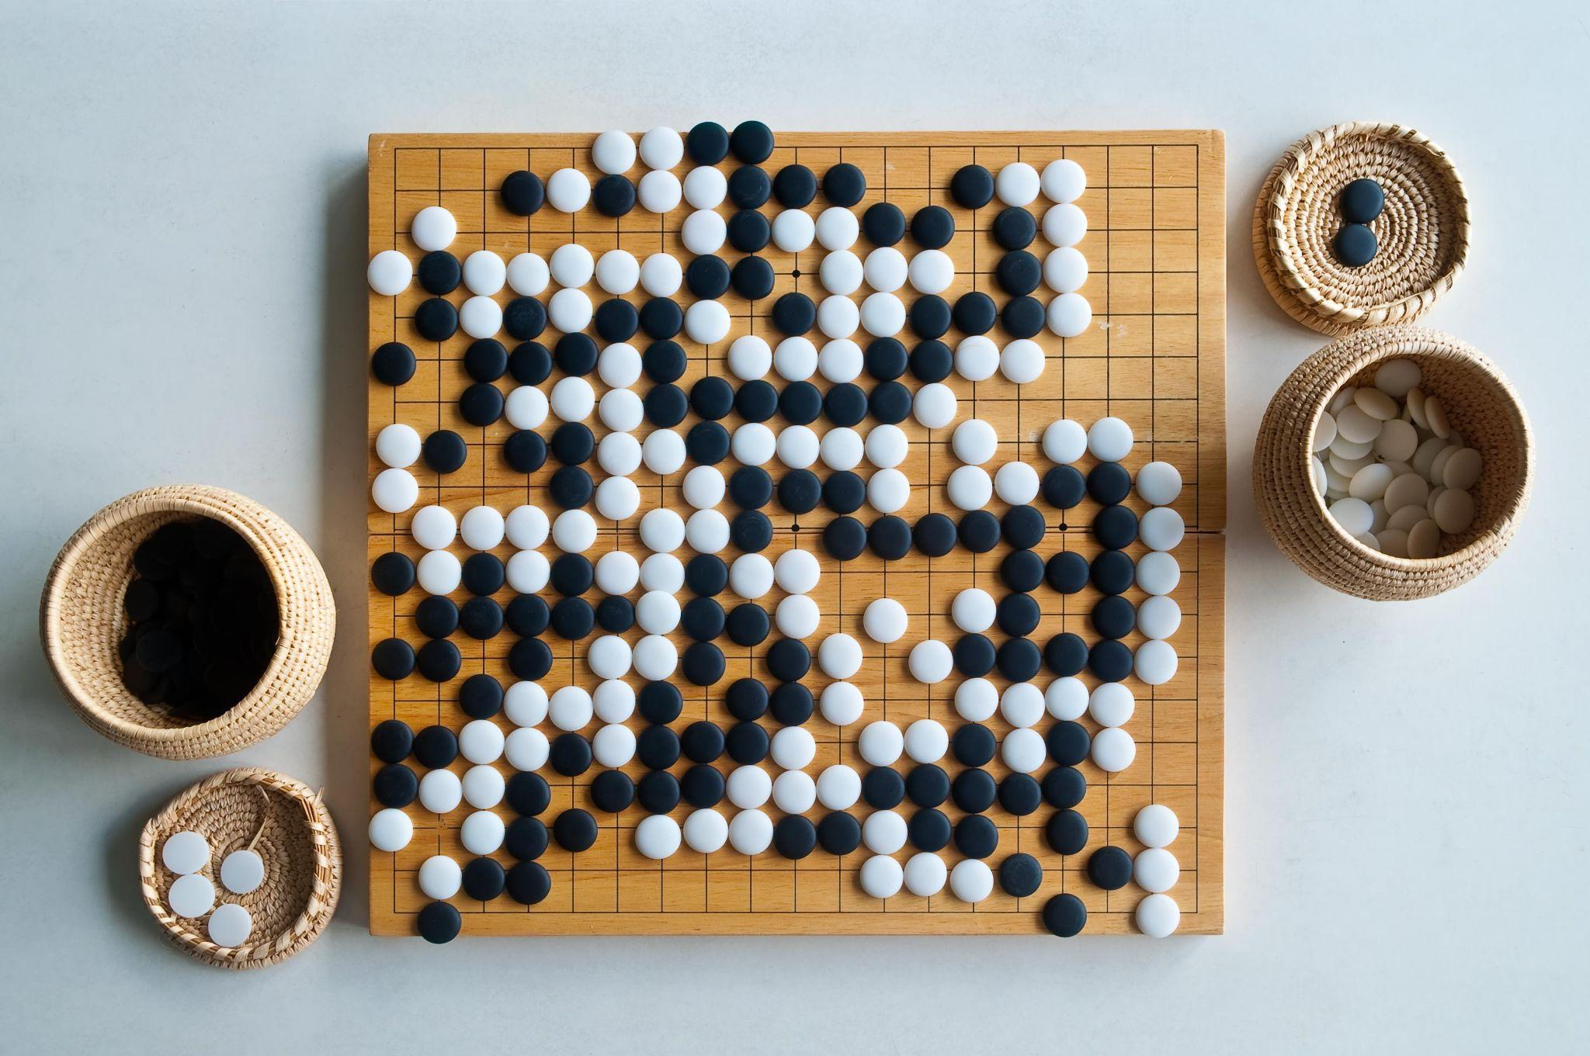

Slide 12
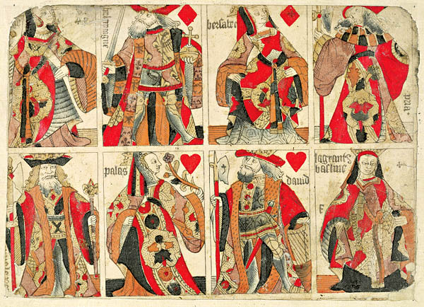
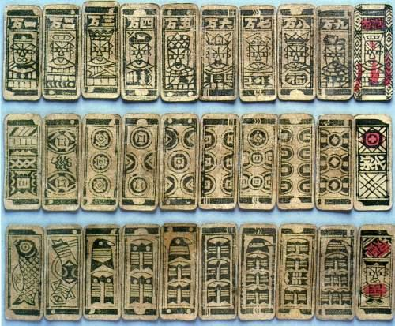

Slide 13
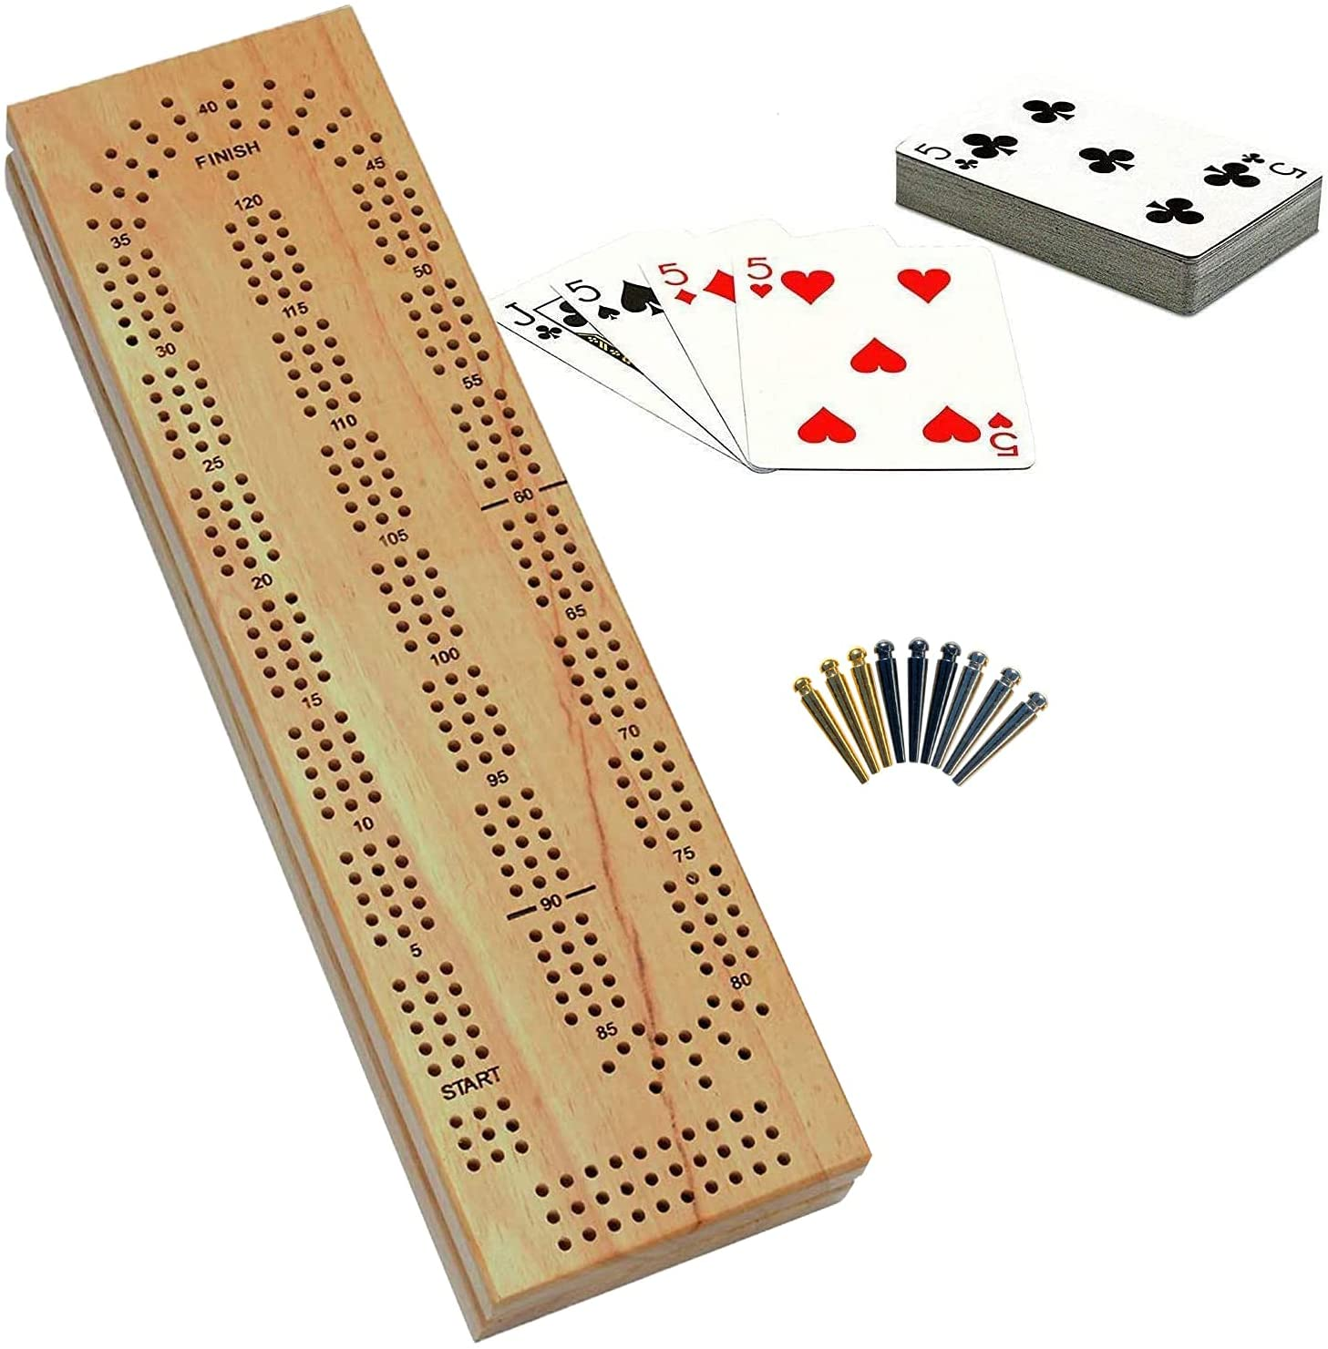

Slide 14
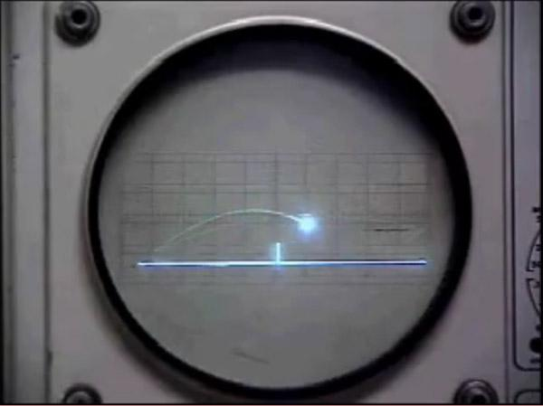

Slide 15
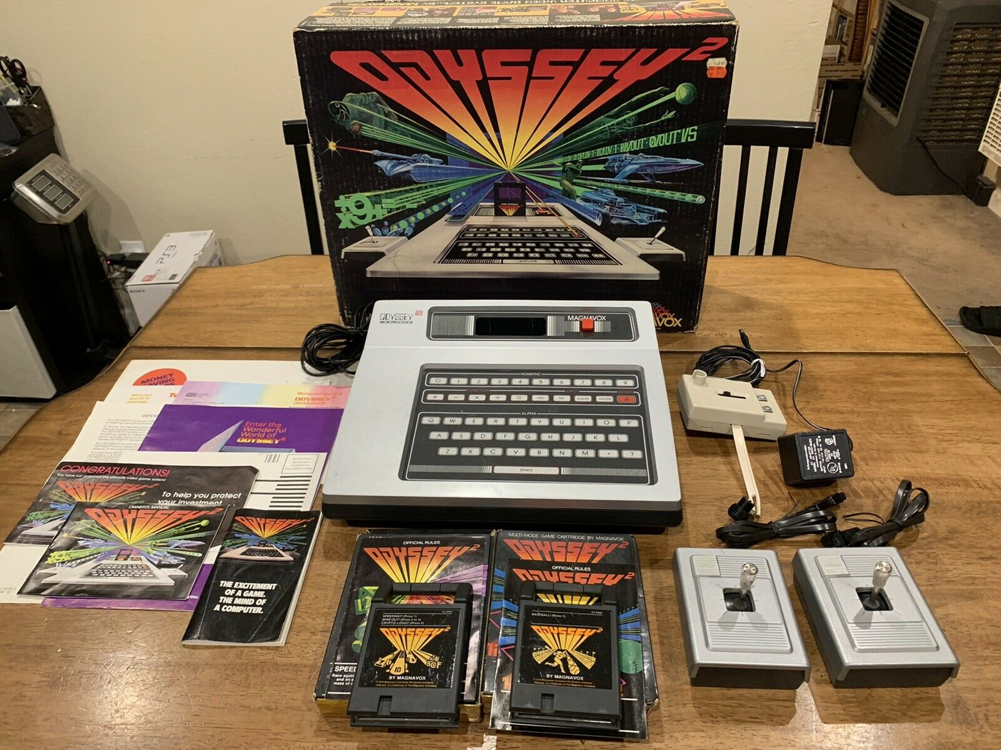

Slide 16
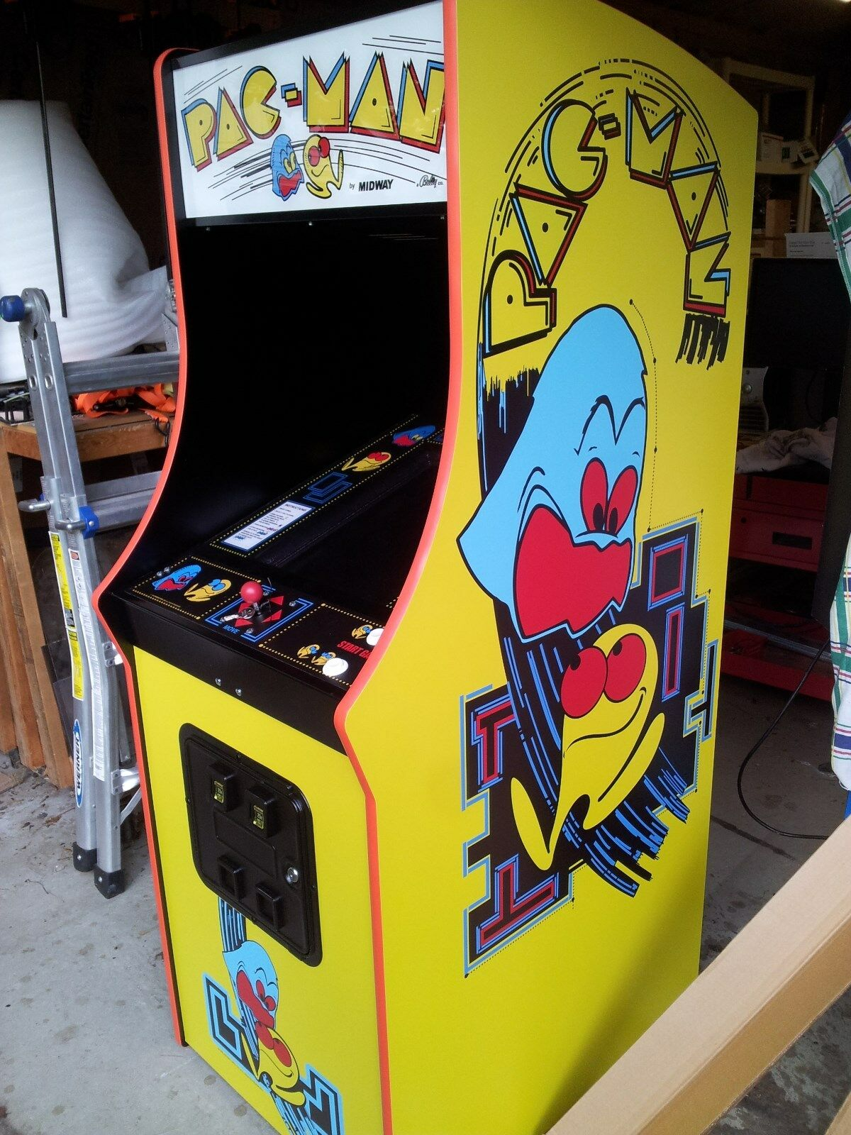

Slide 17
Art History and Games

Slide 18
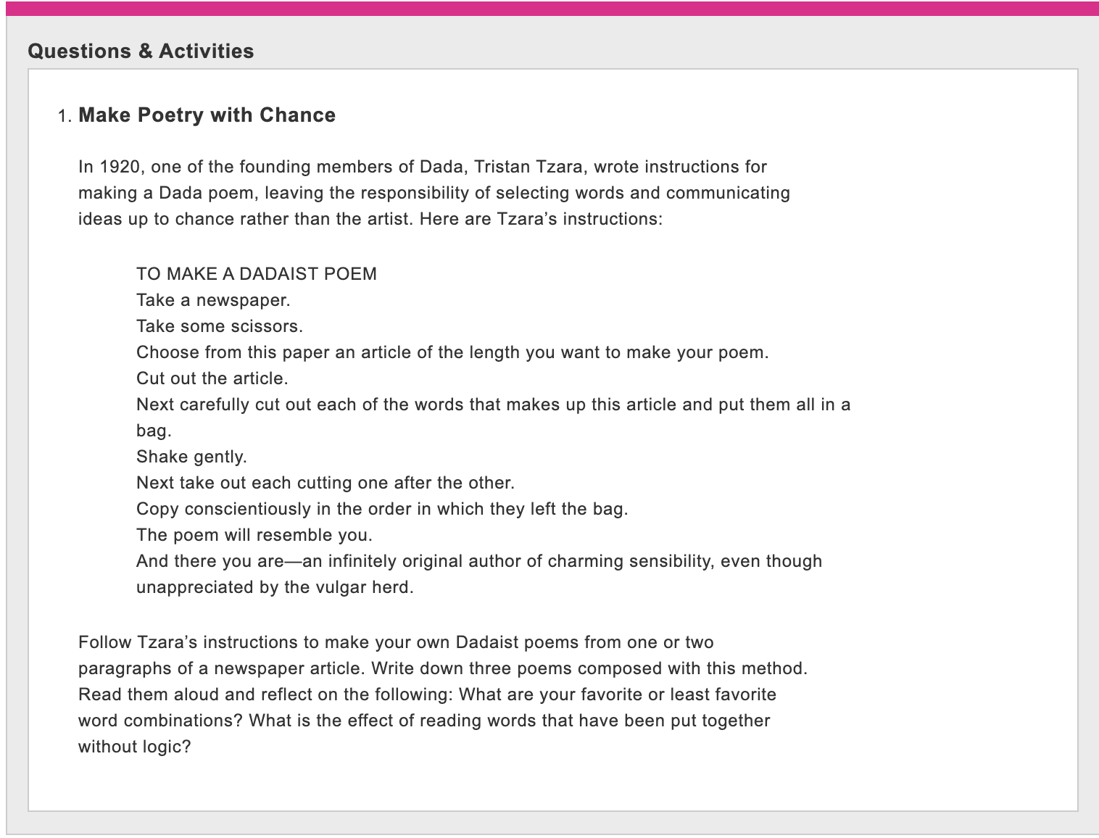

Slide 20
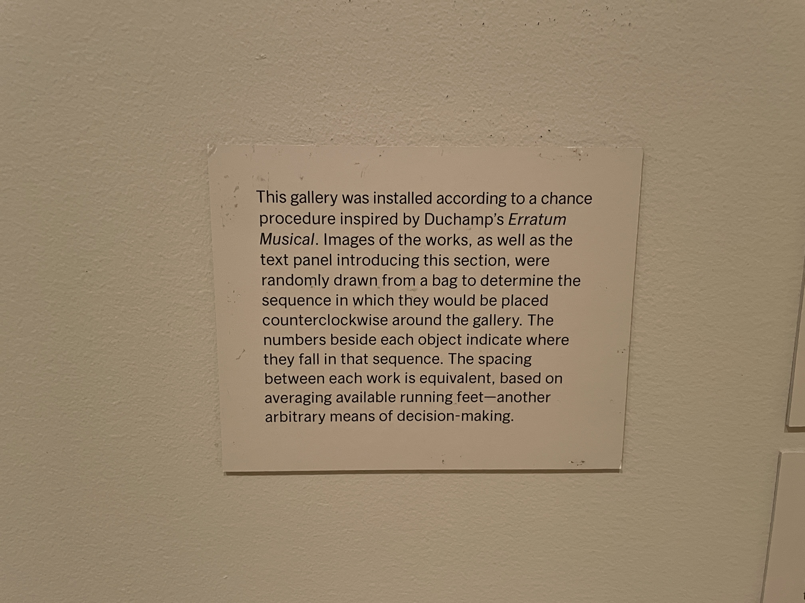

Slide 21
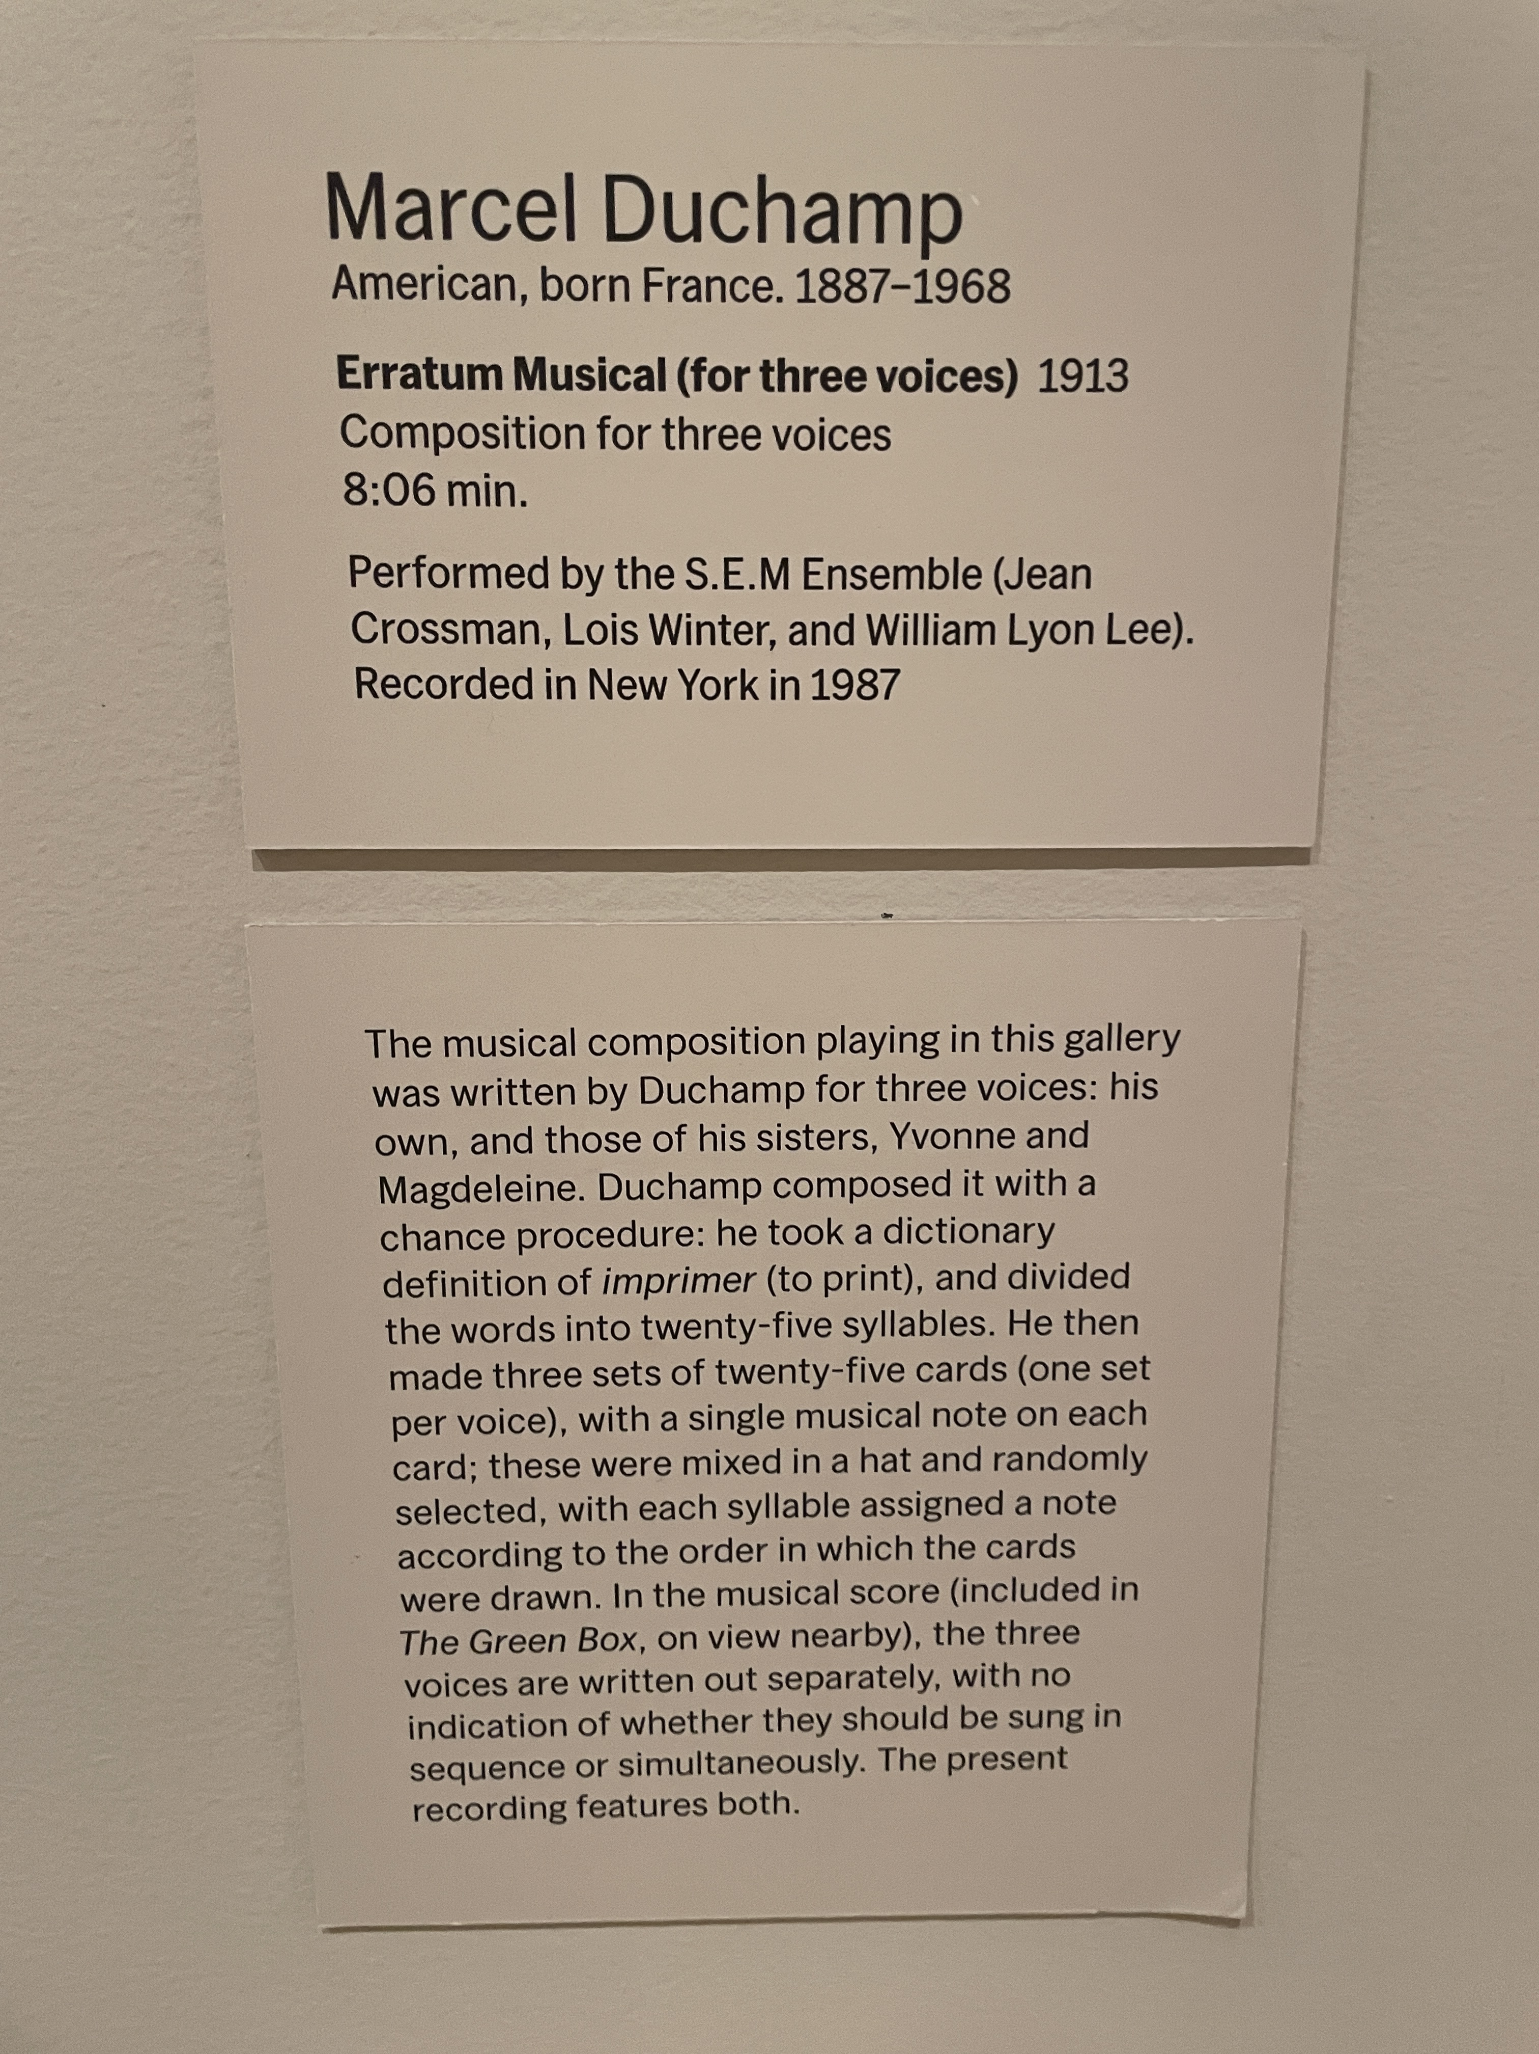

Slide 24
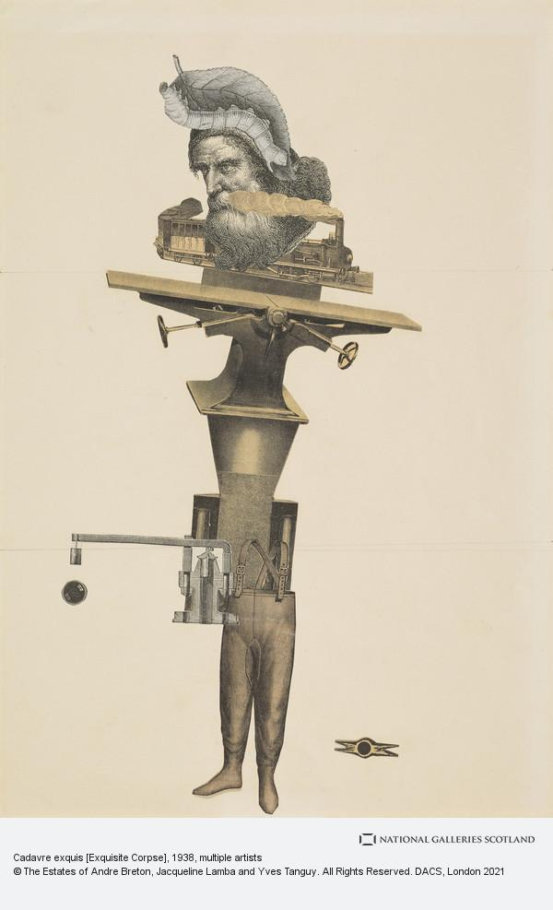
André Breton, Jacqueline Lamba et Yves Tanguy

Slide 26
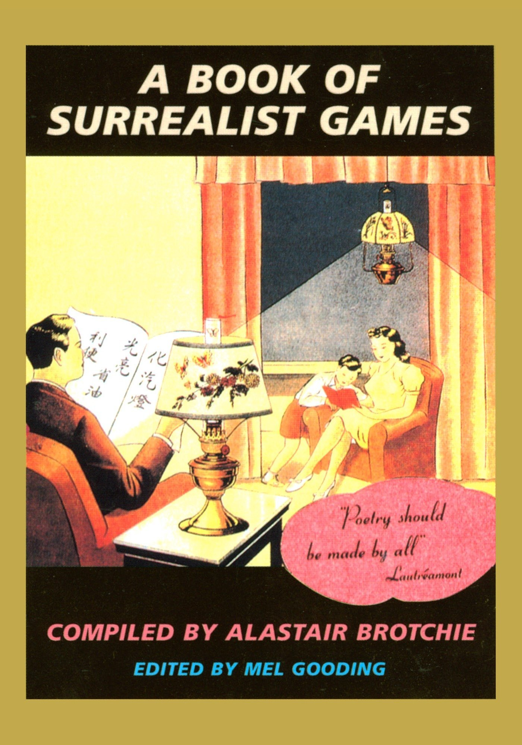

Slide 29
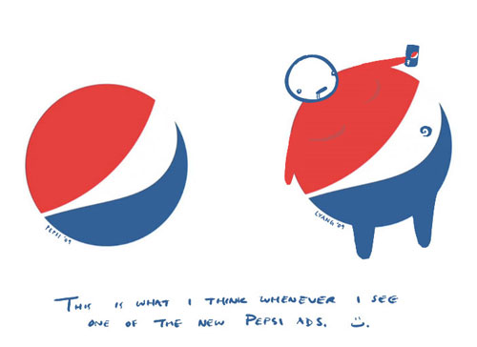

Slide 30
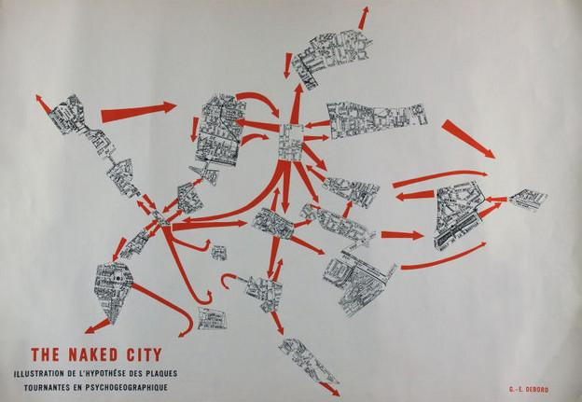

Slide 31
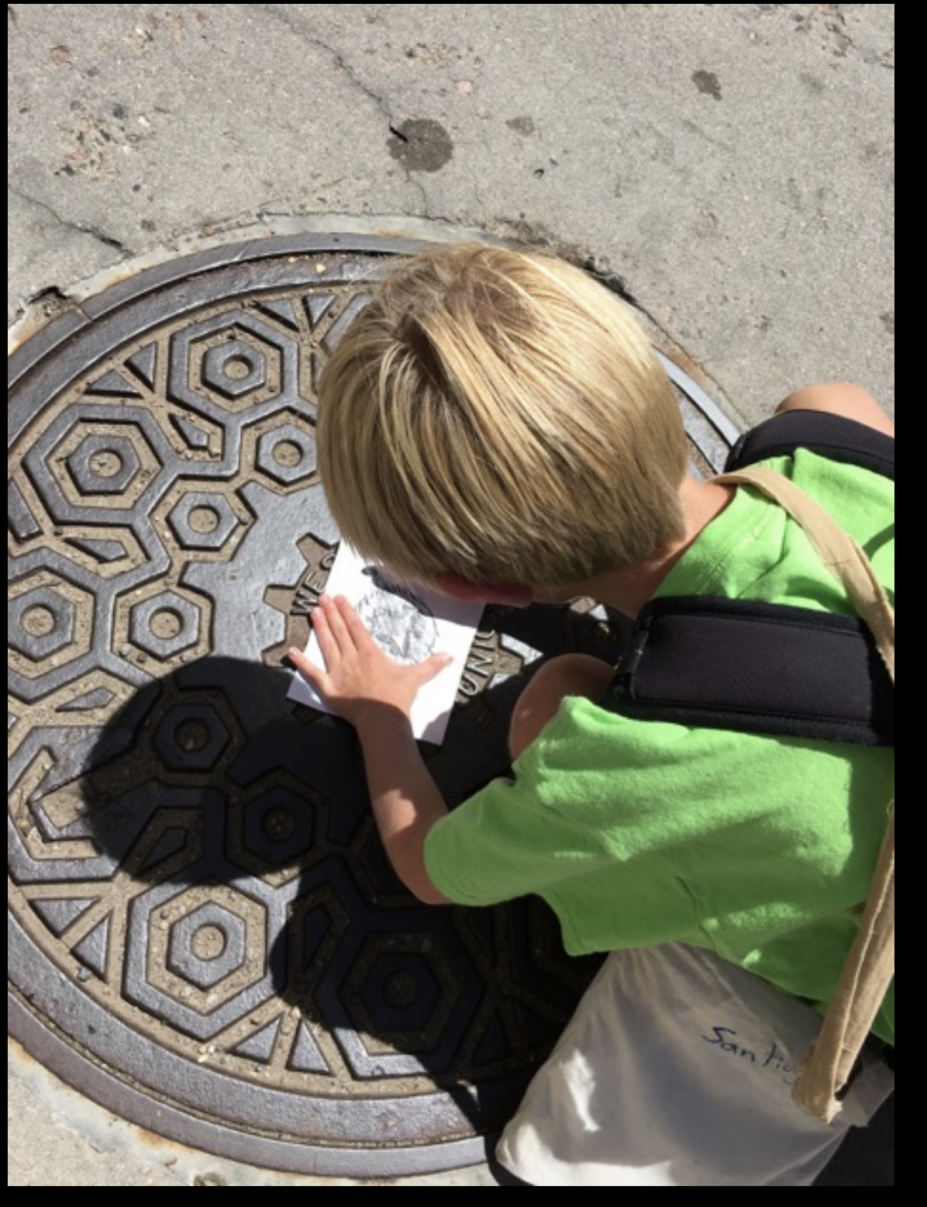

Slide 32
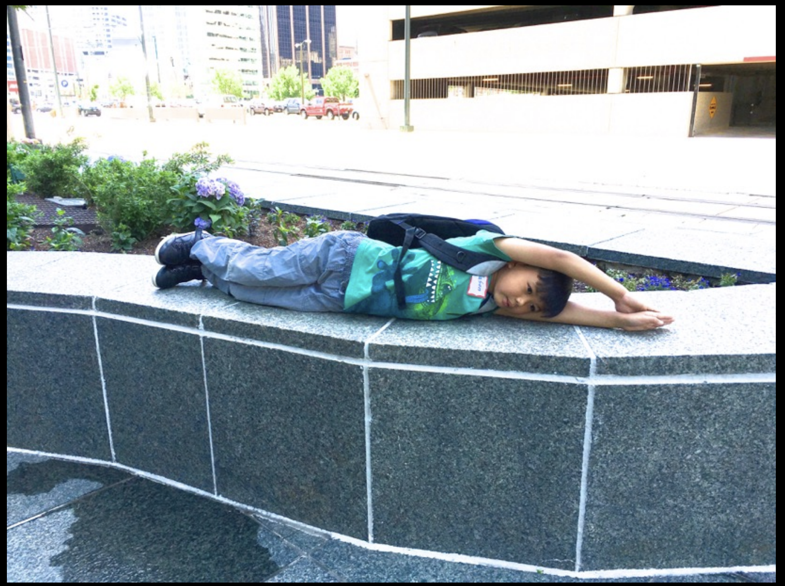

Slide 33
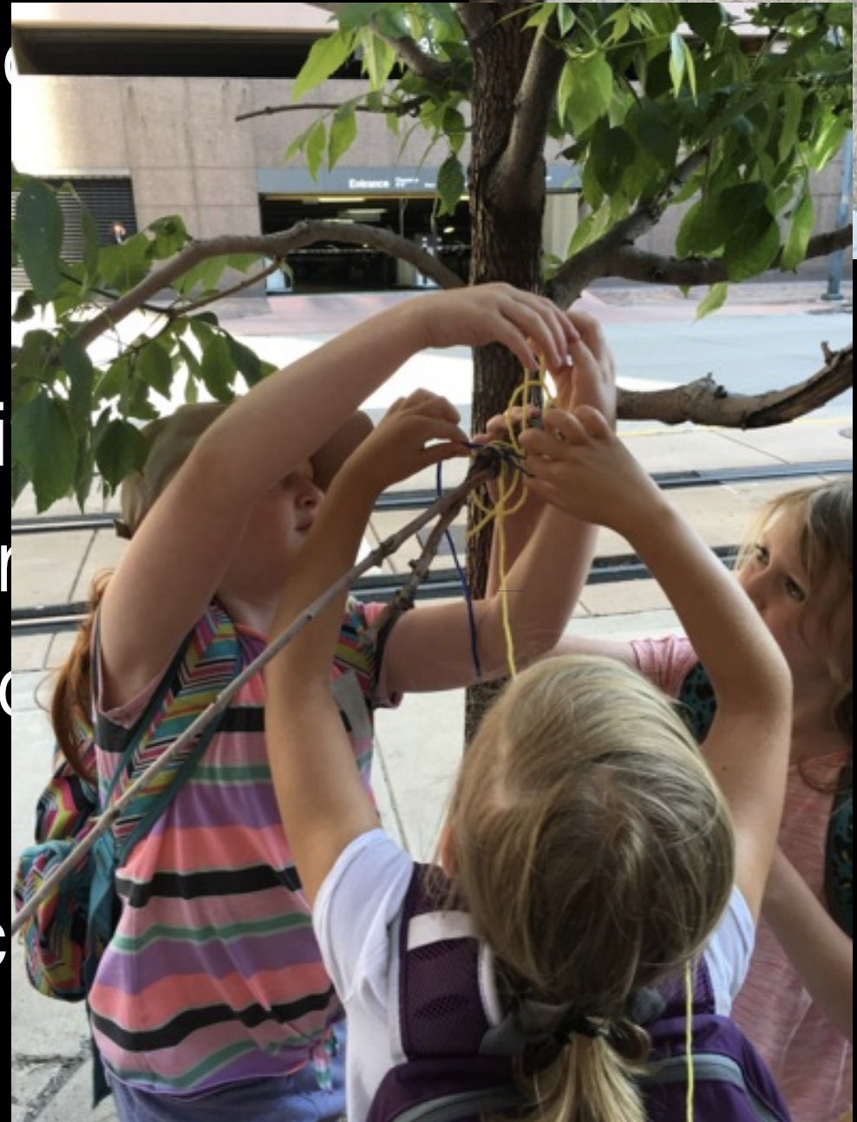

Slide 34
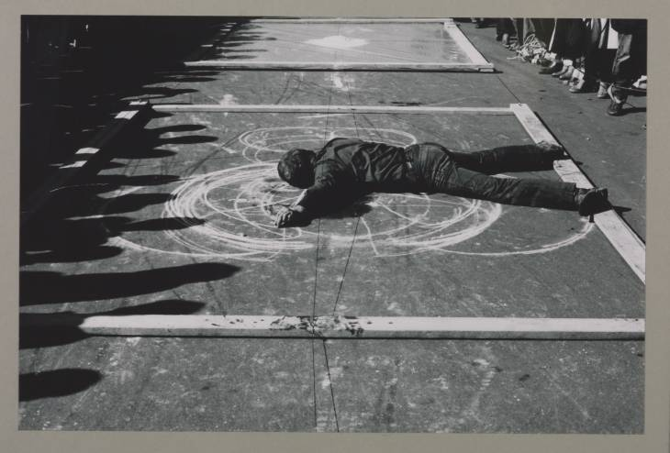

Slide 35
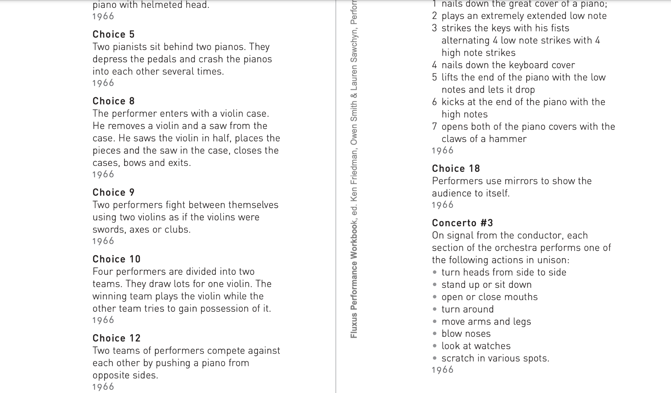

Slide 36
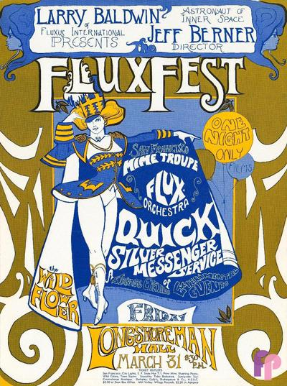

Slide 37
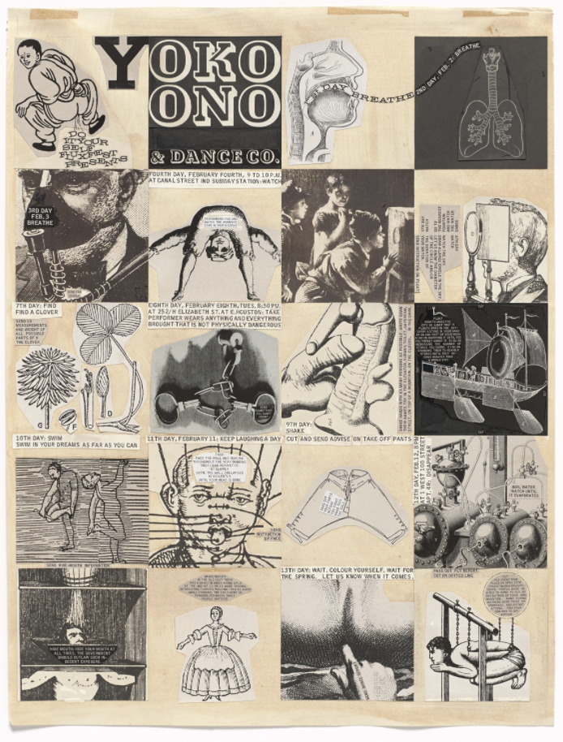

Slide 39
Contemporary Approaches to Games
Cory Arcangel Super Mario Clouds (.gif representation), 2002.

Slide 41
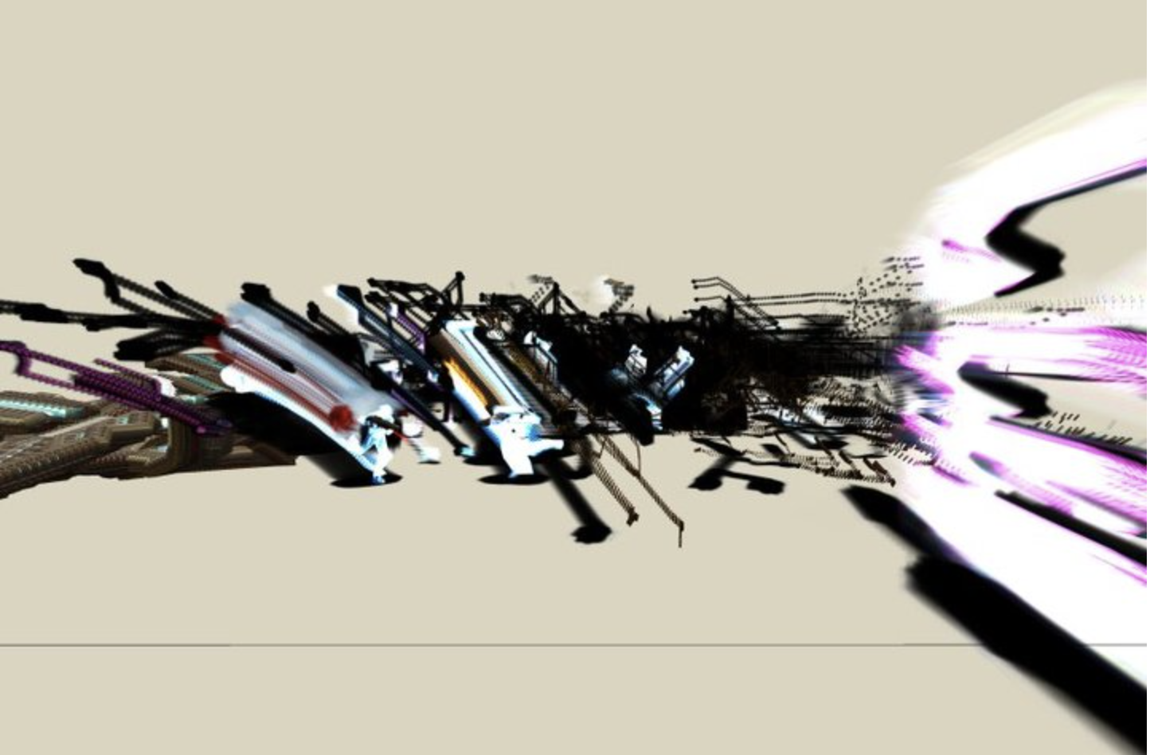

Slide 42
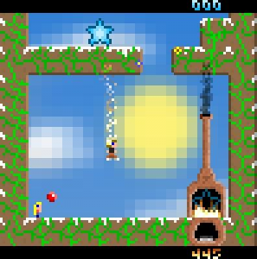

Slide 43
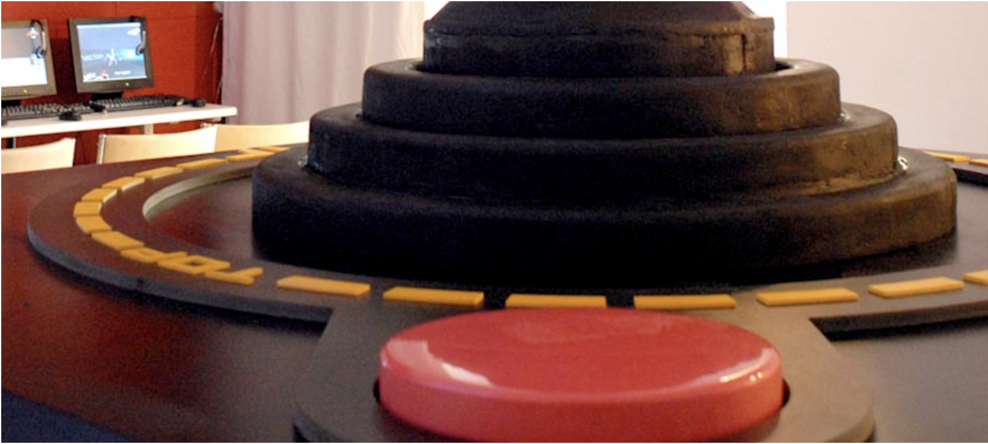

Slide 44
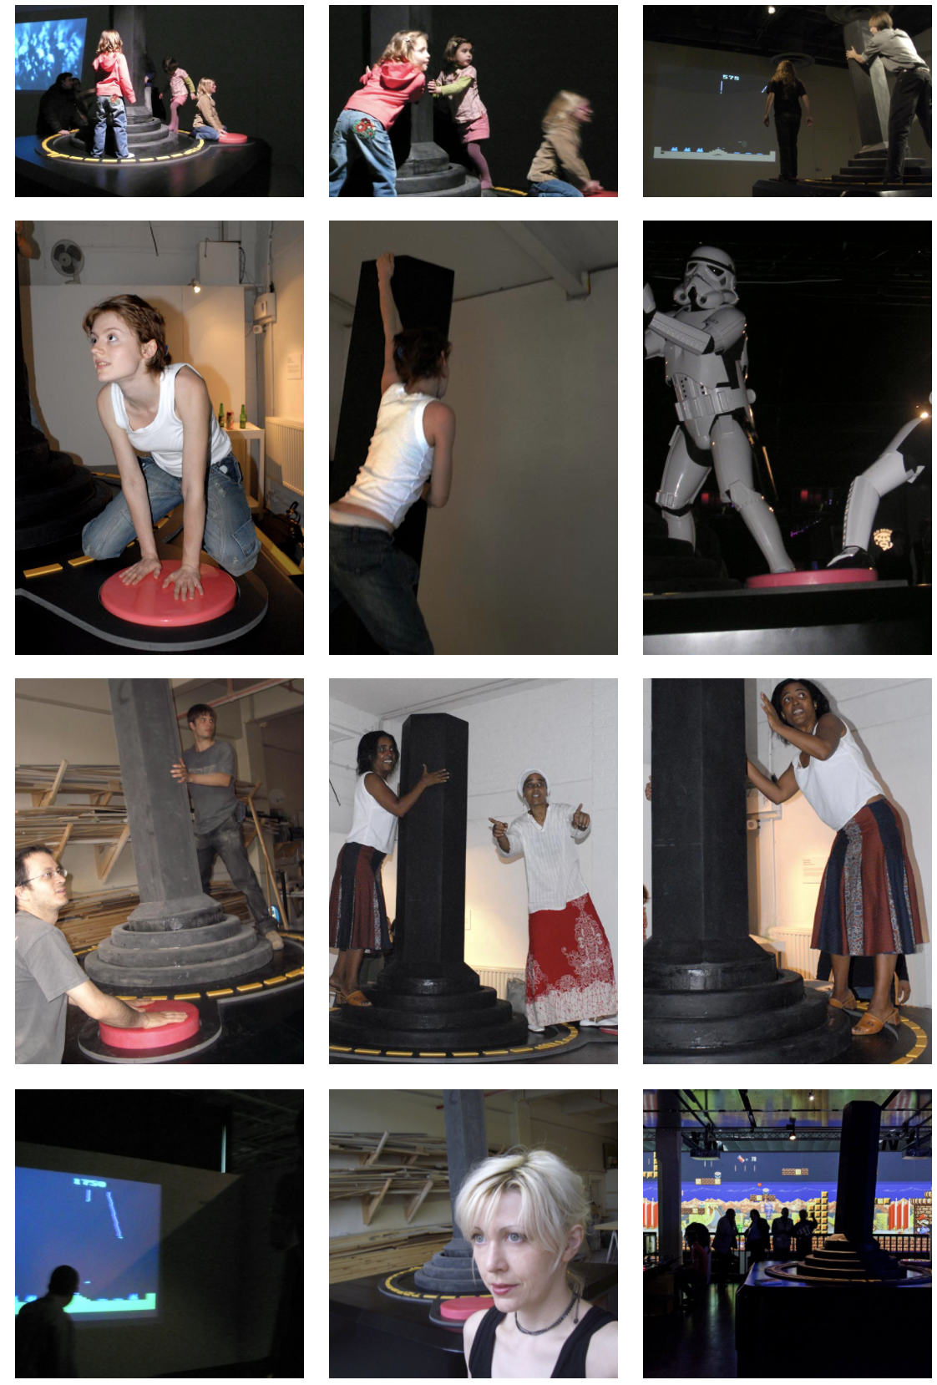

Slide 45
Gaming Literacy: What is it?

Slide 48
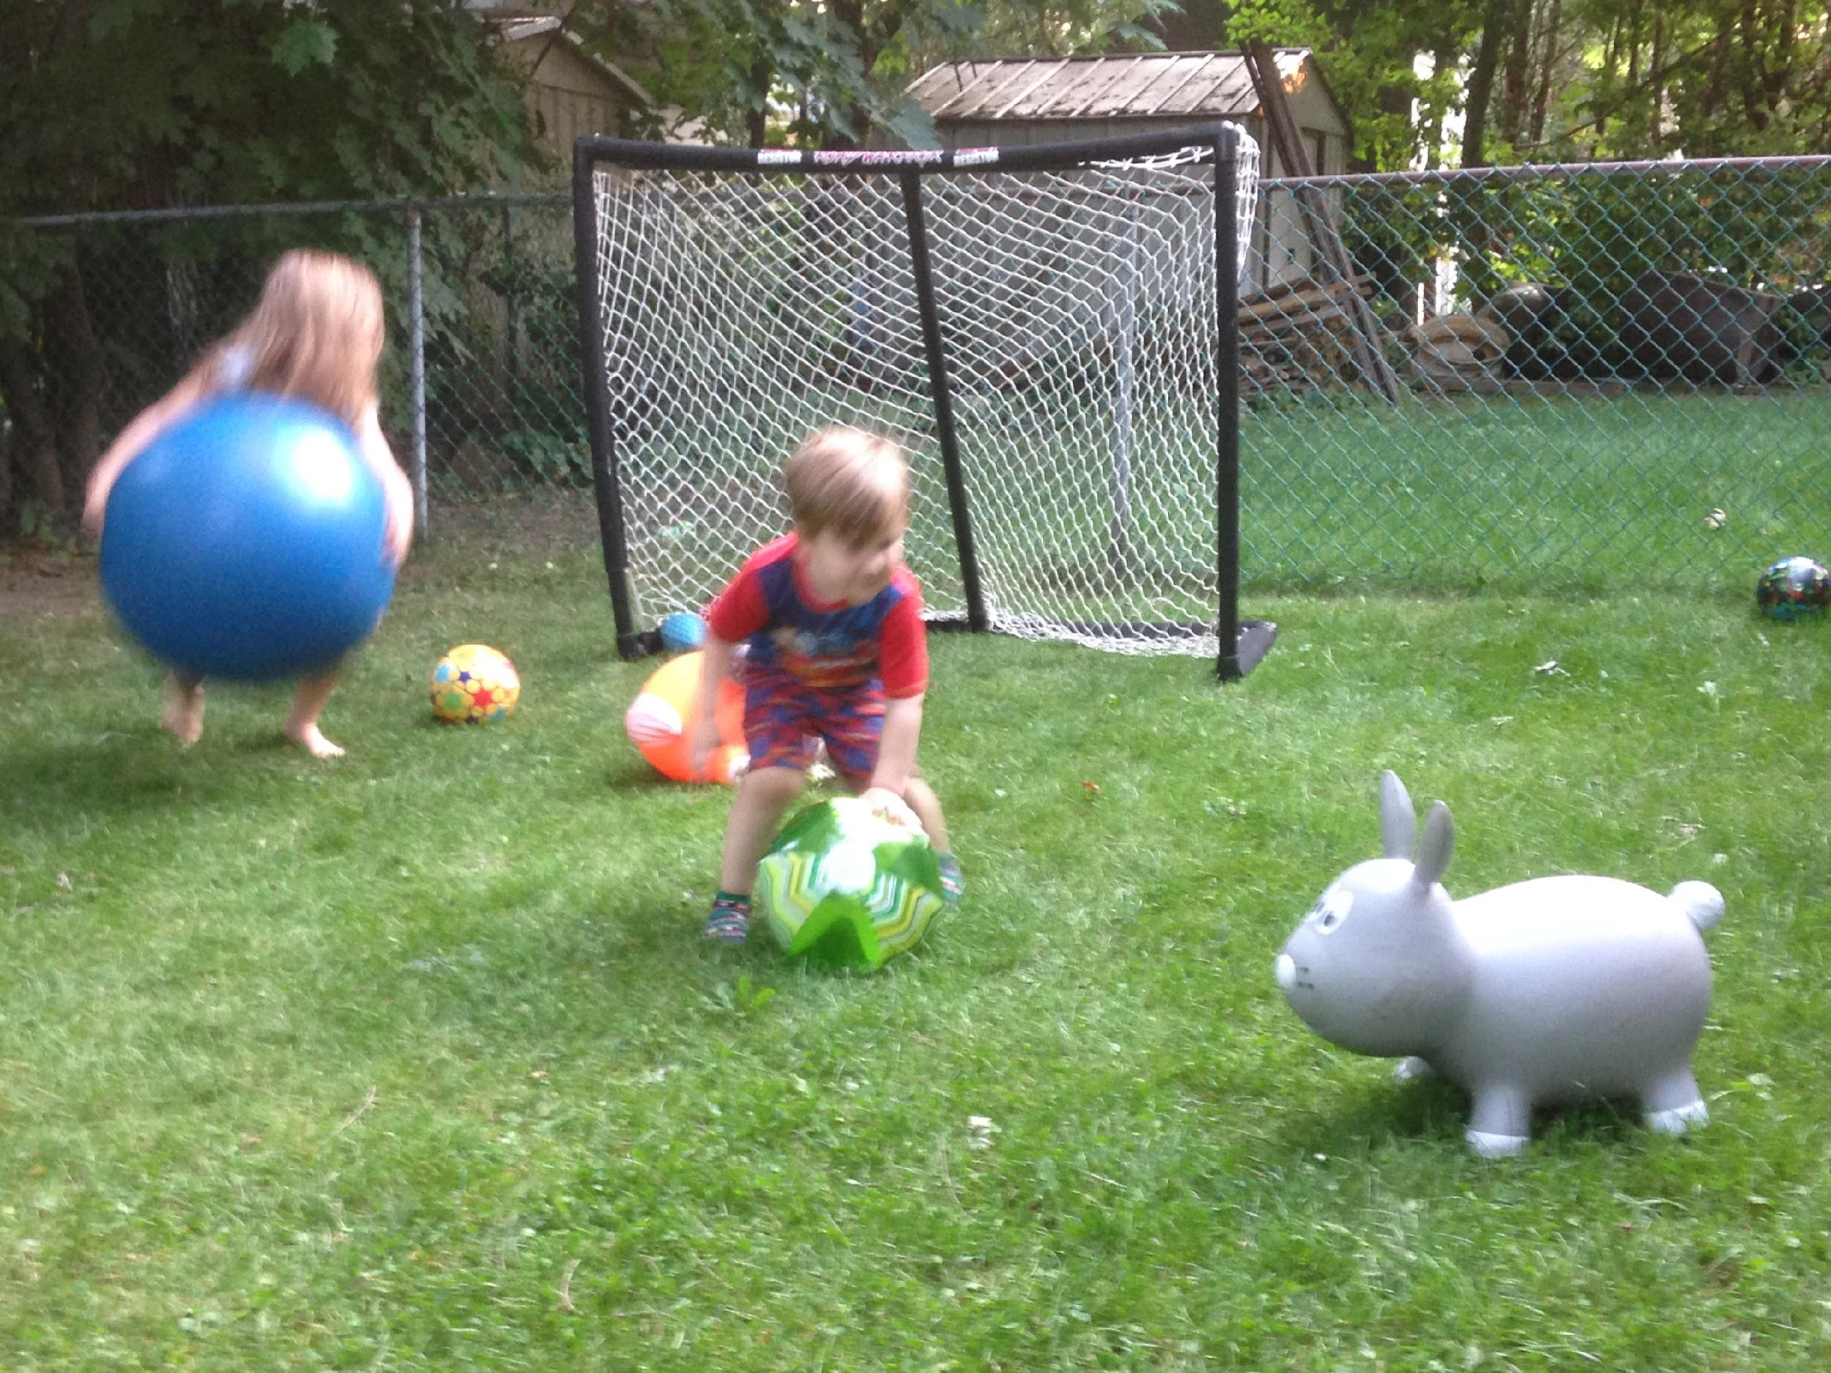
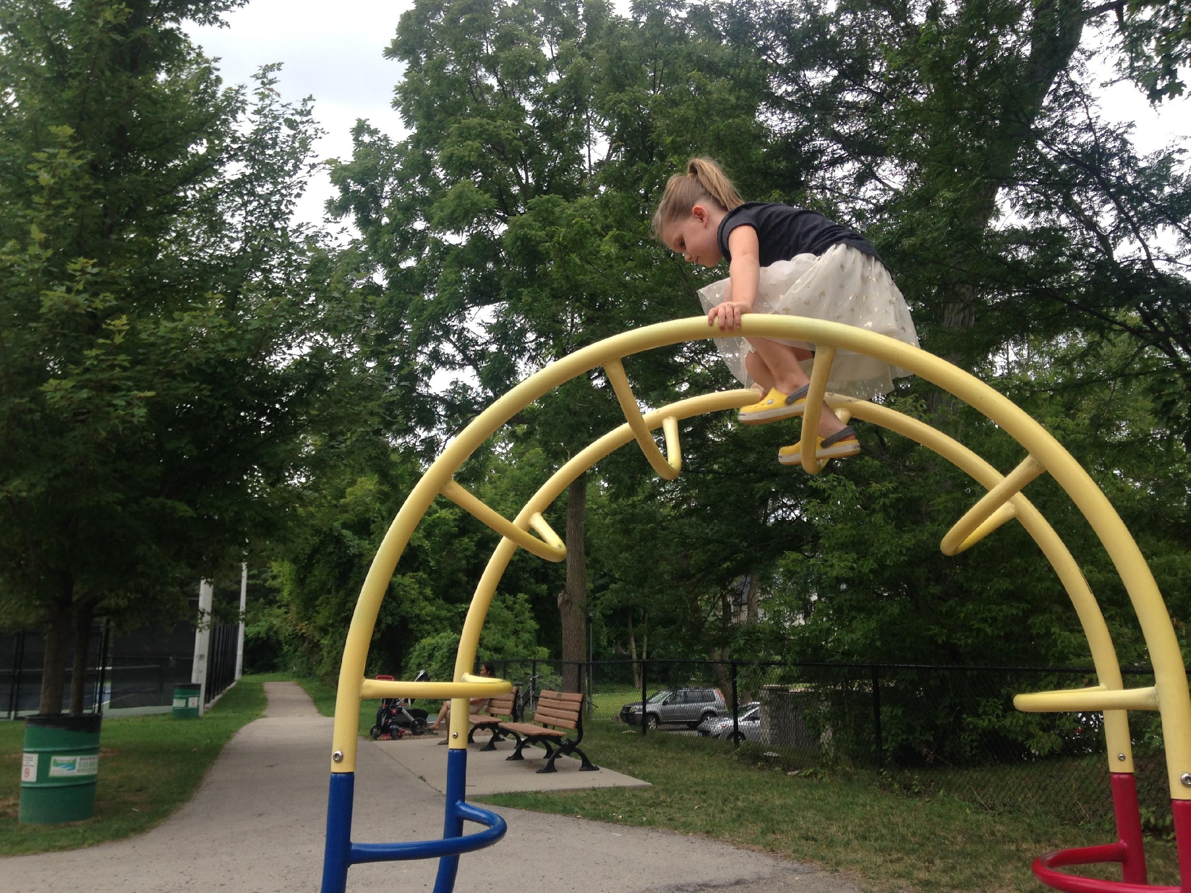

Slide 49
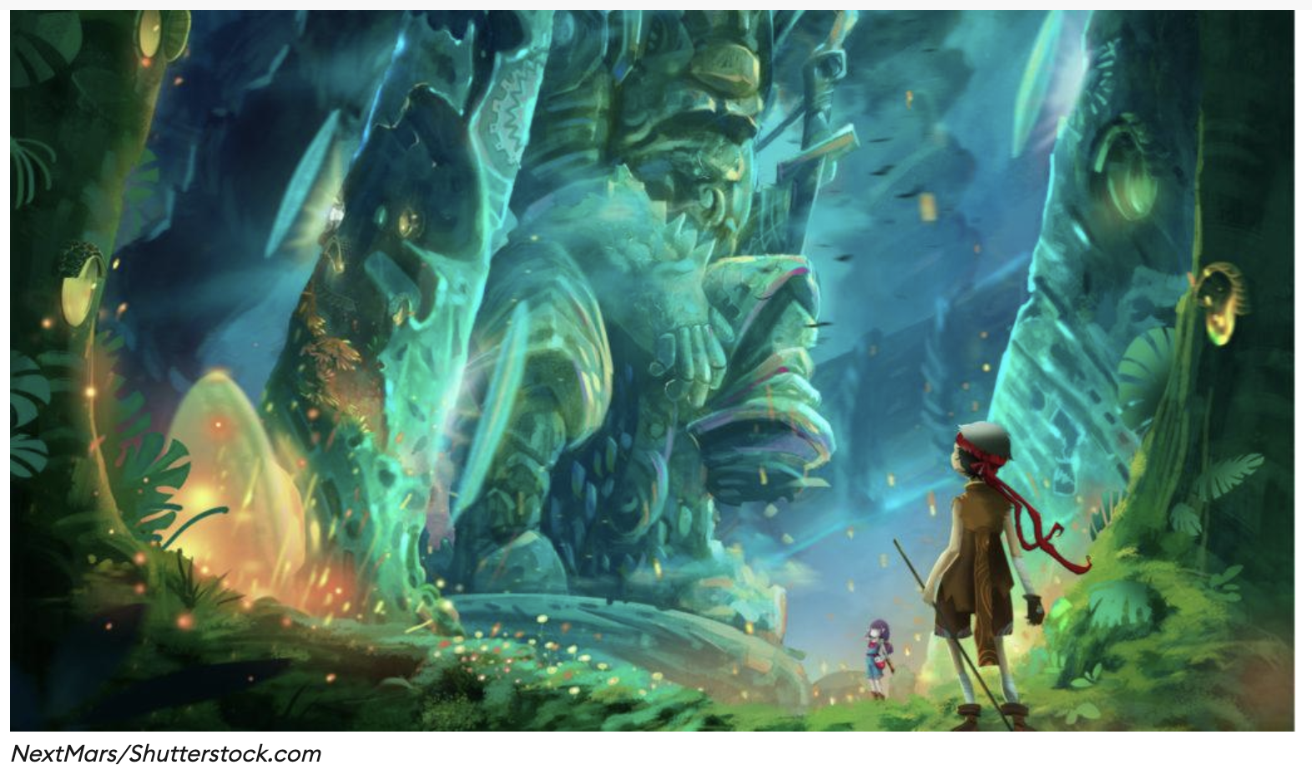

Slide 50
Incorporating Gaming Literacy into Art Curriculum

Slide 51
Challenge #1: Dissection
Take a simple game – in this case, rock, paper, scissors. With your students you can try simple card games like go fish for this as well. Play a few rounds of r, p, s with the person to your right right now.
What are the rules?
What are the win/lose conditions?
What are the if/then statements?
With students have them then alter the rules, w/l conditions and if/then statements and then try out their new game - ITERATIVE DESIGN

Slide 52
Challenge #2: The goal of the game
With the same partner, using any materials you have on you, or no materials at all choose a goal and create a game that could be played right now:
Select a goal card

Slide 53
Goal Cards
Create a game where the goal is to hit/reach a target.
Create a game where you accumulate points for doing something and the person with the most points wins
Create a game where something has to be accomplished in a certain amount of time
Create a game where the first person to accomplish something wins
Create a game that involves engaging with a stranger
Create a game where you have to collaborate to achieve a goal

Slide 54
Challenge#3: Rejig
With a simple game that already exists OR a classic game tool/object – your goal is to create your own game starting with the material
What are the rules
What are the if/then statements
What are the win/lose conditions

Slide 55
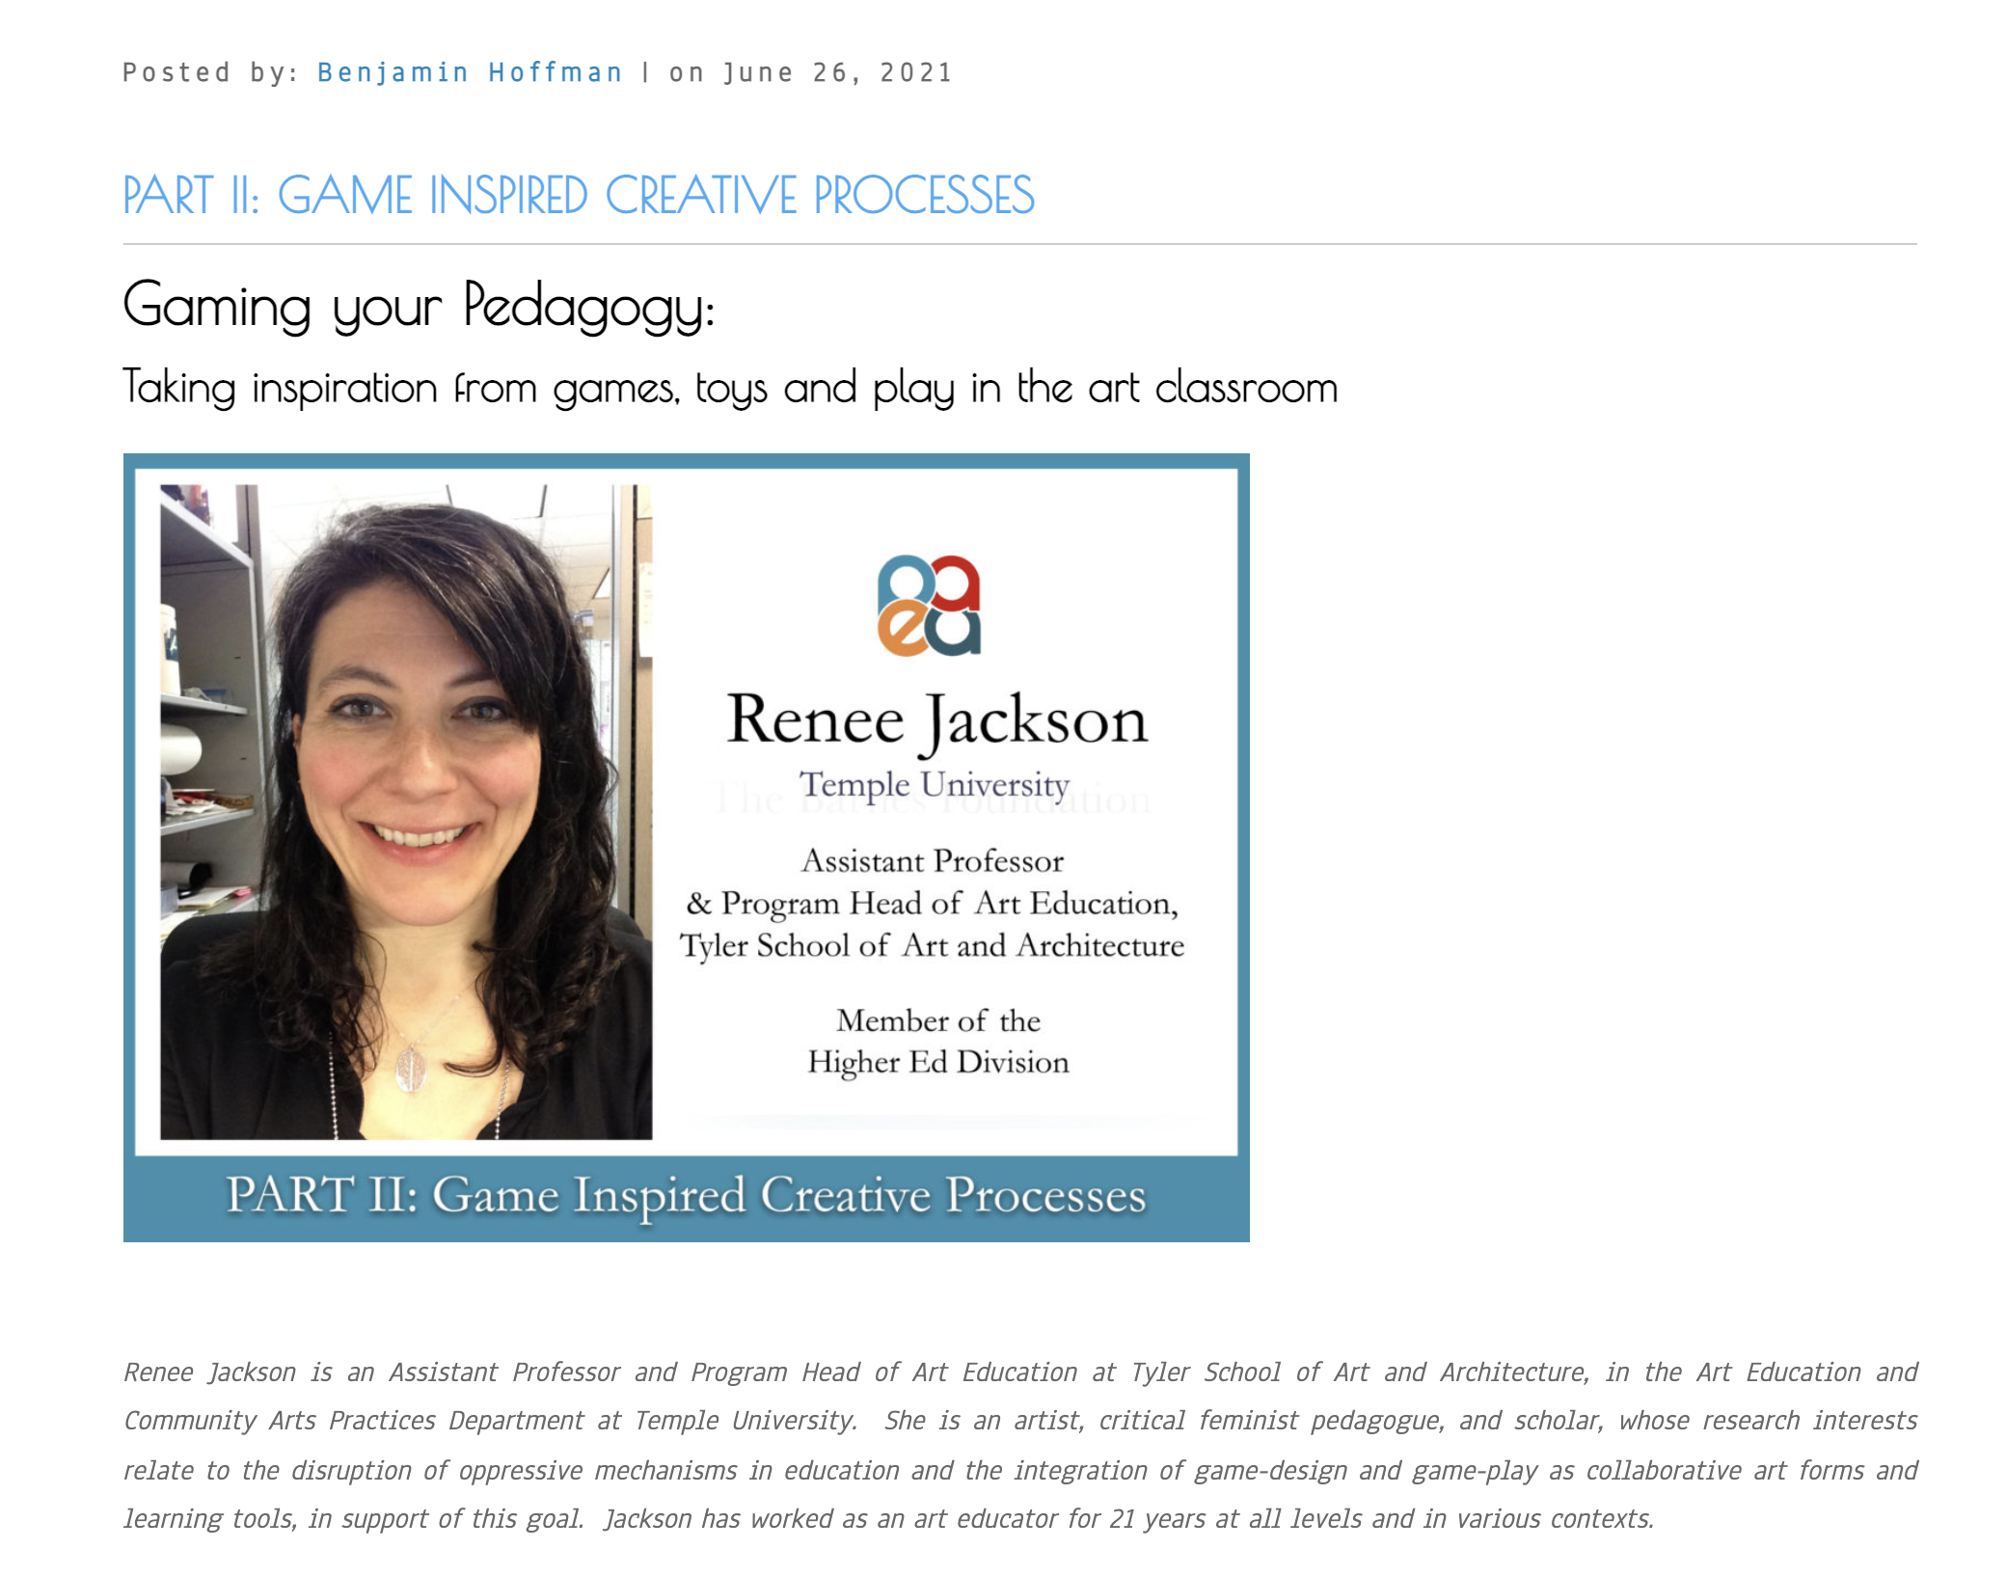
http://paeablog.org/blog/

Slide 56
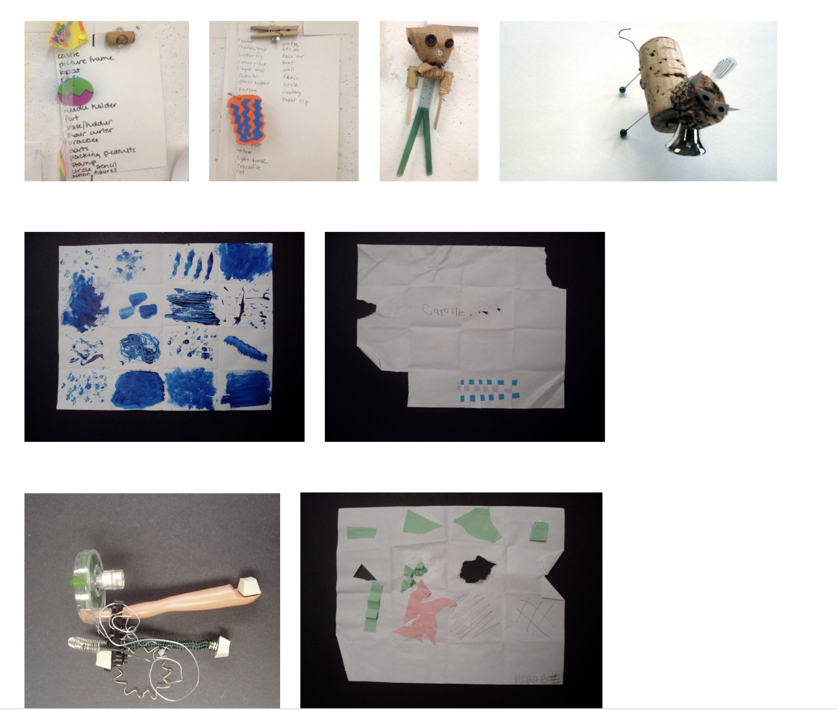

Slide 57
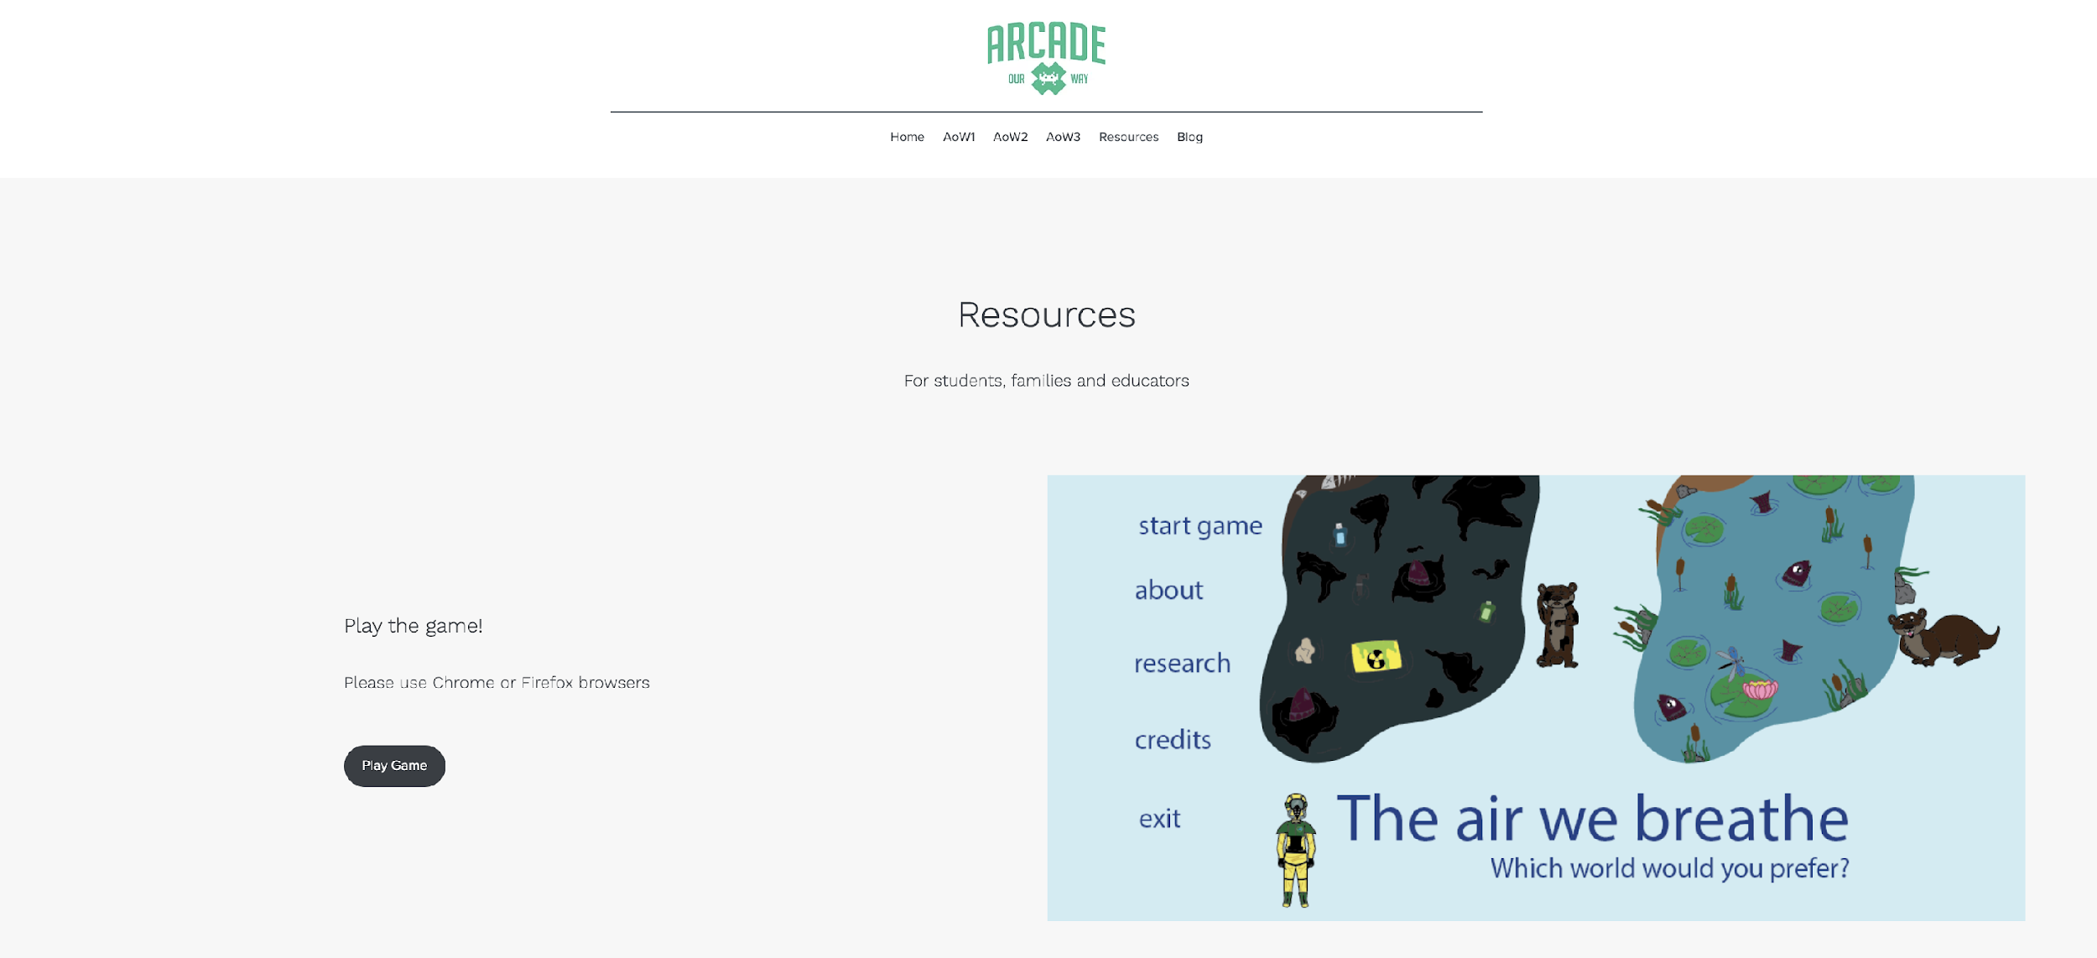
https://www.arcadeourway.com

